Slide 1
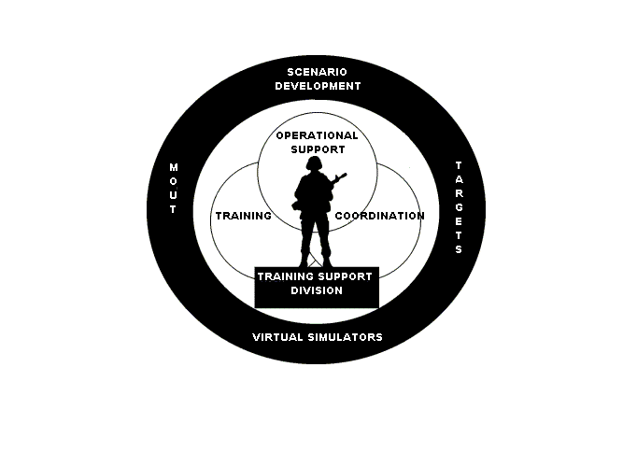
Training Support Division
Building 2238
Phone: 760-725-6139
mcb_campen_tsd_trg_dev@nmci.usmc.mil

Slide 2
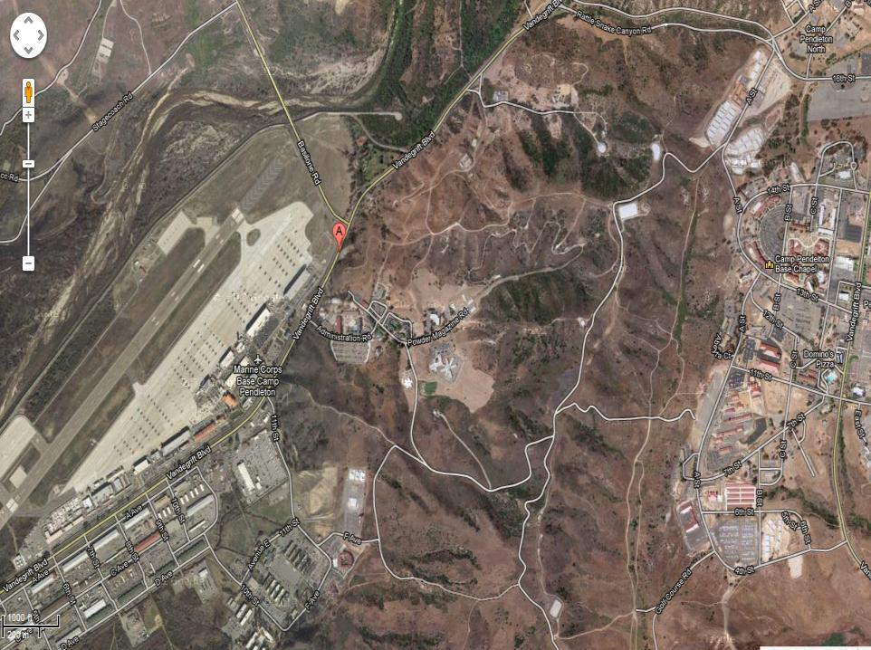
Bldg 2238

Slide 3
Clothing

Slide 4
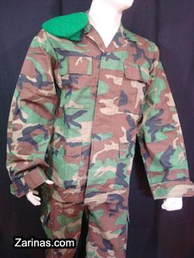
Afghanistan Army Uniform

Slide 5
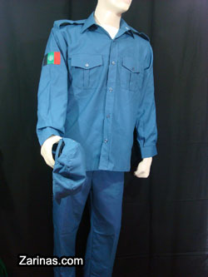
Afghanistan Police Uniform

Slide 6
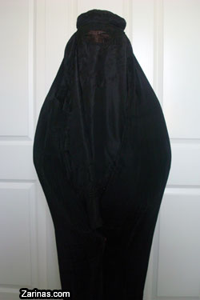
Burqa

Slide 7
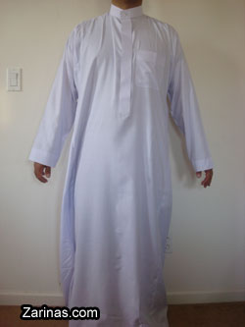
Dishadasha (Man Dress)

Slide 8
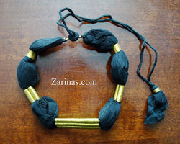
Egal

Slide 9
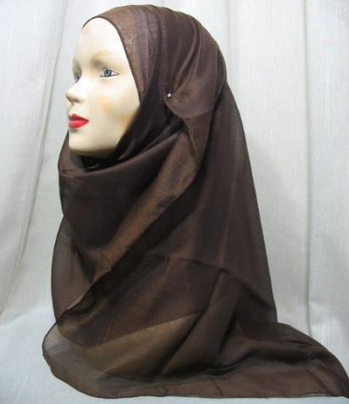
Hijab

Slide 10
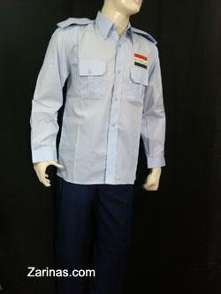
Iraqi Police Uniform

Slide 11
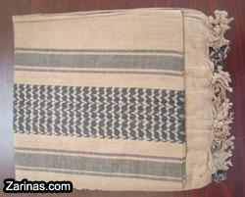
Kaffiyeh (Scarf)

Slide 12
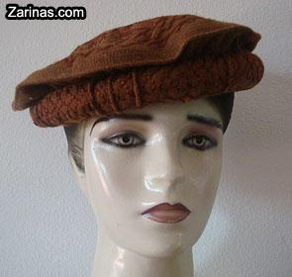
Pakol

Slide 13
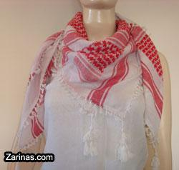
Shimagh (Head Scarf)

Slide 14
IED /Mines/ Ammunition

Slide 15
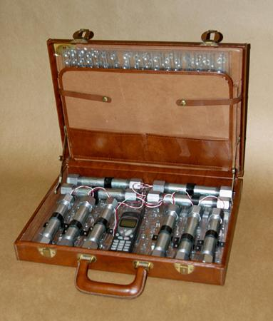
Briefcase Bomb

Slide 16
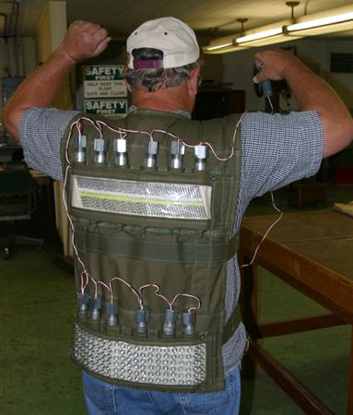
Suicide Bomb Vest

Slide 17
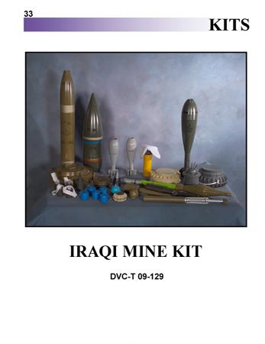
Iraqi Mine Kit

Slide 18
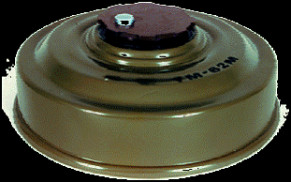
Land Mine

Slide 19

Mortar

Slide 20
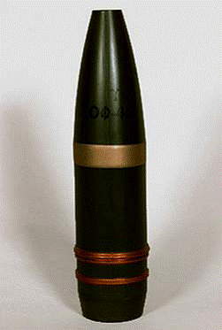


Projectile

Slide 21
Weapons

Slide 22
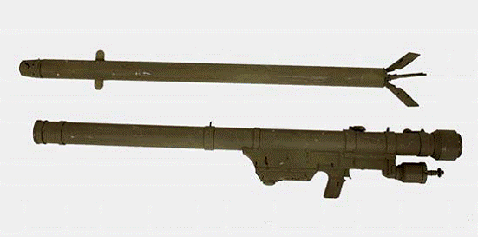
SA7 Grail

Slide 23
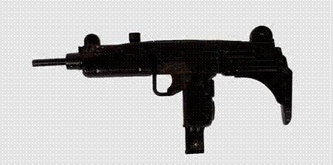
Uzi

Slide 24

Mini Uzi

Slide 25
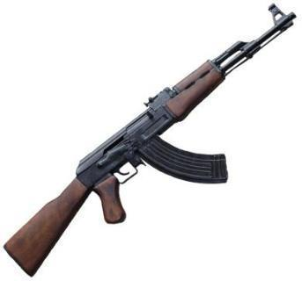
AK47

Slide 26
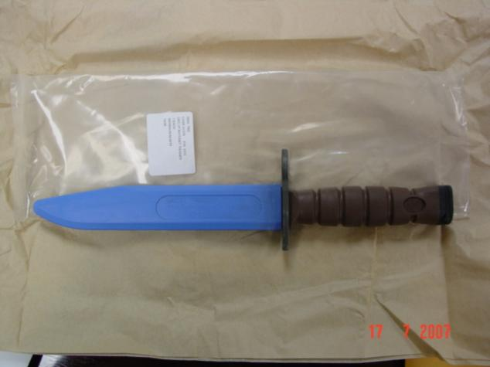
Kabar

Slide 27
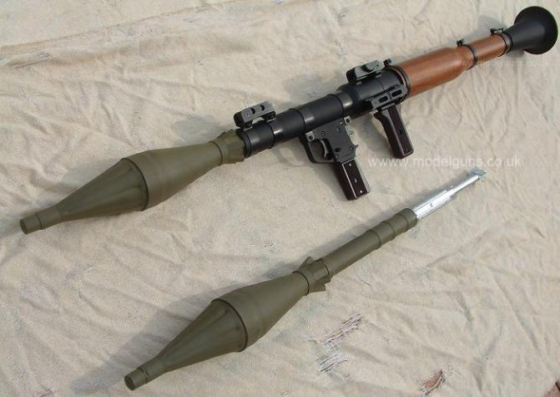
RPG

Slide 28
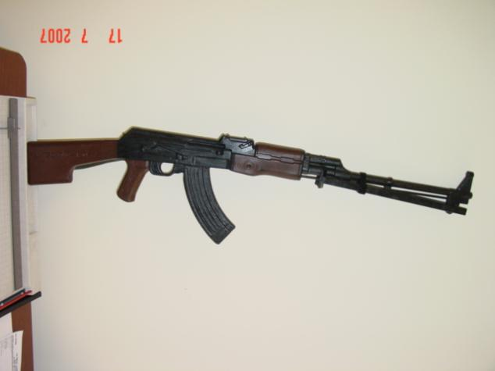
RPK

Slide 29
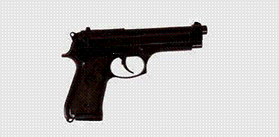
9mm Pistol

Slide 30

Silencer Pistol

Slide 31
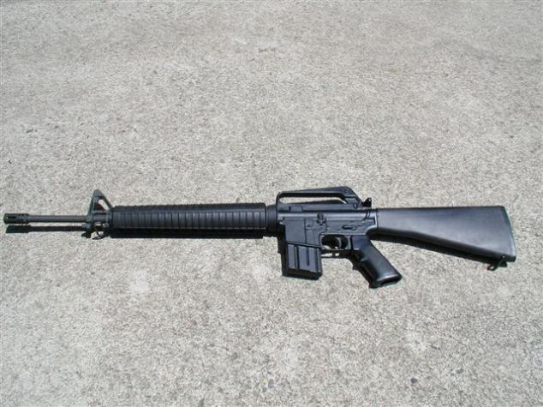
M16

Slide 32
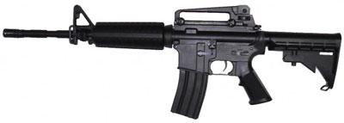
M4

Slide 33
Malice Kits

Slide 34
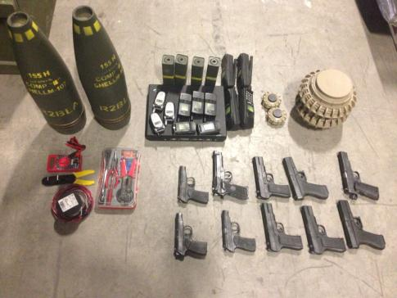
IED Kit

Slide 35
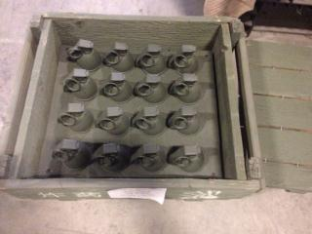
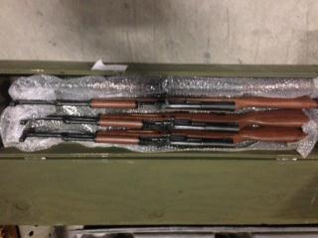
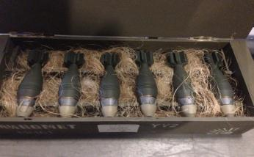
Weapons Cache

Slide 36
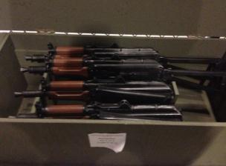
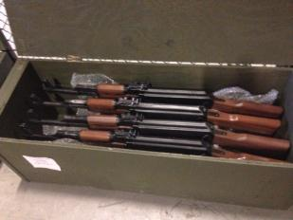
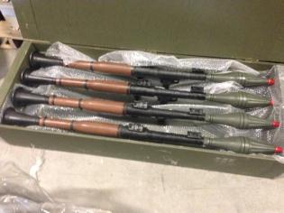
Weapons Cache

Slide 37
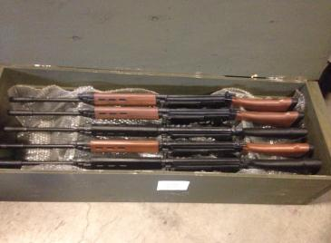
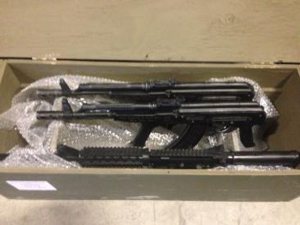
Weapons Cache

Slide 38
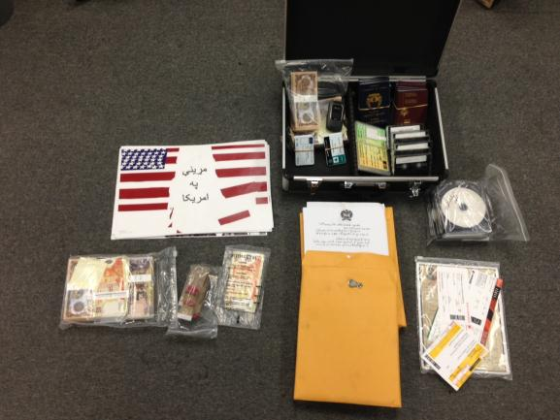
Travel Kit

Slide 39
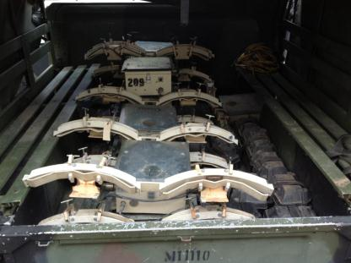
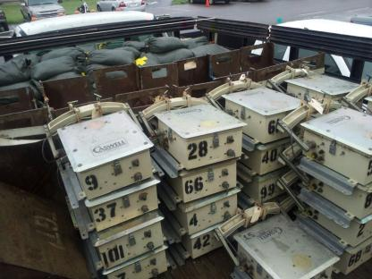
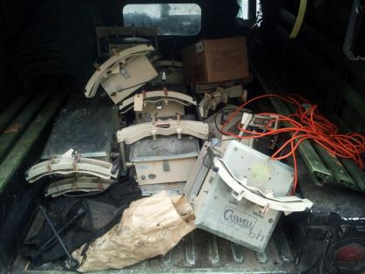
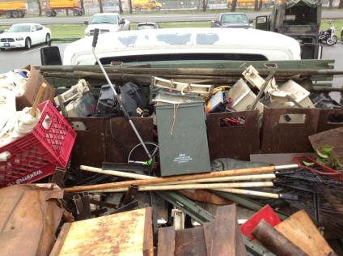
Proper Transportation
Improper Transportation

Slide 40
I want to order
ALL INERT REPLICA MINOR TRAINING DEVICES
M16
M4
AK47
RPG
MINES
AK47
SUCIDE VESTS
AFGHAN CLOTHING
Etc..
Go to:
http://www.pendleton.marines.mil/StaffAgencies/AssistantChiefofStaffG35/TrainingSupportDivision/TrainingDevices.aspx
Fill out the replica/clothing form and email it to:
mcb_campen_tsd_trg_dev@nmci.usmc.mil
Building 2238
Phone: 760-725-6139

Slide 41
Target Systems
Provided by ESP Contractors
725-4805/760-385-5120

Slide 42
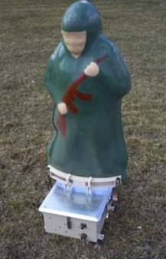
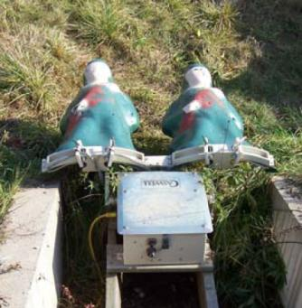
Stationary Infantry Target System
12”x 18”x20”
12VDC Battery
E, F or 3-D target
Hit Sensing: Single Shot and Burst Count Modes
Hit Detection: Target Commands Expose, Conceal,
Hit-Hold, Hit-Fall, Hit-Bob, Hit-Stop
**Extensive Scenario programming available on request

Slide 43
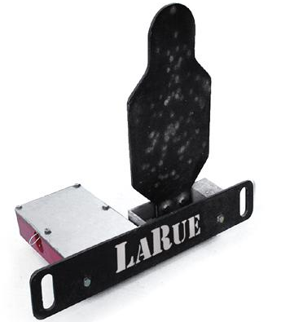

Larue
Battery Powered. Automatically resets 1800 times between charges.
Man Portable. 72 lbs total weight.
Self Contained. No assembly required, no set-up, no hoses, no wires!
Battle Tough. 3/8" thick 500 Brinnell target. Withstands .223s and .308s.
Weather Proof. Leave LaRue Targets out year-round.
Timed to reset in 9 seconds,
then automatically shuts off
in upright position, saving
power (until hit again).

Slide 44
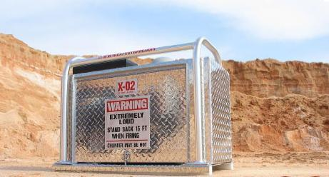
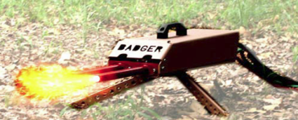
Simulators
O2 Cylinder (20 cu ft)~150 shots/fill
Propane Cylinder (4.25lbs)~250 shots/fill
All Components Enclosed
One Man Lift/Two Man Carry
Remote operated AK47 simulator
600 rounds per minute
Bursts and single round fire
Realistic flash
500 yds line of sight

Slide 45
I want to order
Badger Simulators
XO 2 Simulators
Portable Infantry Targets
LaRues
SESAMS
T-IED Simulators
ITESS Equipment
Training
Go to:
http://gtssw-espinc1.com
Or call:
760-385-5120 / 760-725-4805

Slide 46
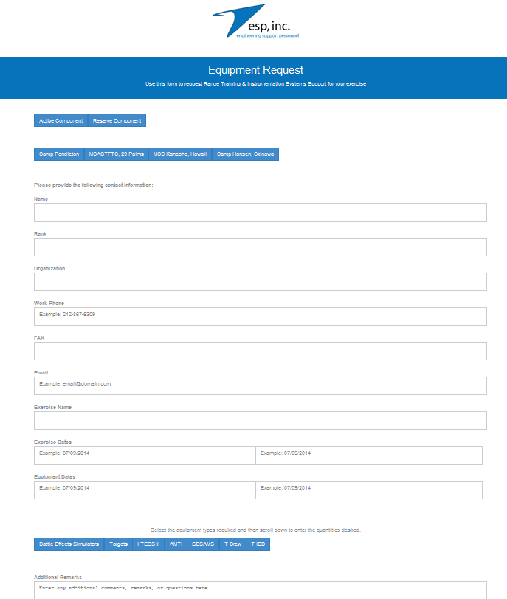
Process
Click Active/Reserve
Choose Location
Fill in information
Click type of systems wanted
  More requested space will show
  Fill in requirements
Any other information place in the comments box: for example training needed, specific extra equipment not listed.
Click submit
A pop up will appear stating a successful transaction.
Within 24 hours a tech will call you.
Note there is a directory on the site incase of changes or more information is needed.

Slide 47
