Slide 1
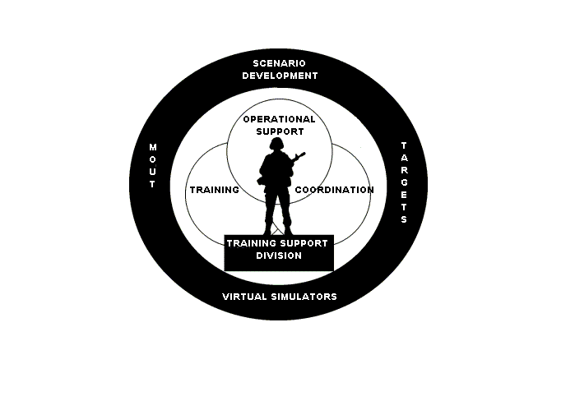
Training Support Division
Building 2238
Phone: 760-725-6139
mcb_campen_tsd_trg_dev@nmci.usmc.mil

Slide 2
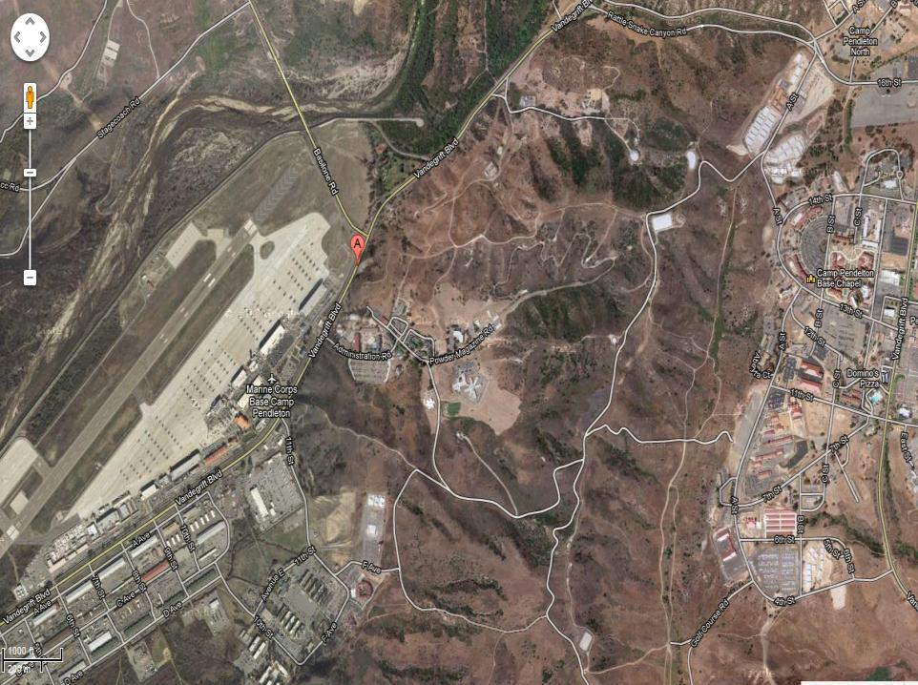
Bldg 2238

Slide 3
Target Systems

Slide 4
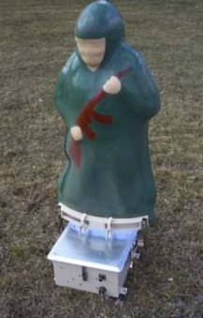
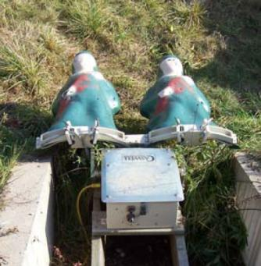
Stationary Infantry Target System
12”x 18”x20”
12VDC Battery
E, F or 3-D target
Hit Sensing: Single Shot and Burst Count Modes
Hit Detection: Target Commands Expose, Conceal,
Hit-Hold, Hit-Fall, Hit-Bob, Hit-Stop
**Extensive Scenario programming available on request

Slide 5
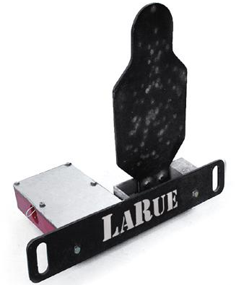

Larue
Battery Powered. Automatically resets 1800 times between charges. Man Portable. 72 lbs total weight. Self Contained. No assembly required, no set-up, no hoses, no wires! Battle Tough. 3/8" thick 500 Brinnell target. Withstands .223s and .308s. Weather Proof. Leave LaRue Targets out year-round.
Timed to reset in 9 seconds,
then automatically shuts off
in upright position, saving
power (until hit again).

Slide 6
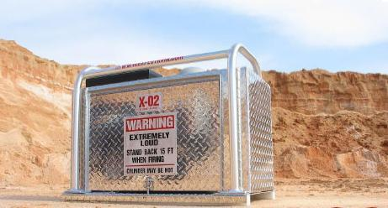
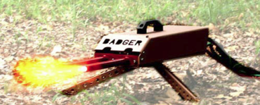
Simulators
O2 Cylinder (20 cu ft)~150 shots/fill
Propane Cylinder (4.25lbs)~250 shots/fill
All Components Enclosed
One Man Lift/Two Man Carry
Remote operated AK47 simulator
600 rounds per minute
Bursts and single round fire
Realistic flash
500 yds line of sight

Slide 7
Clothing

Slide 8
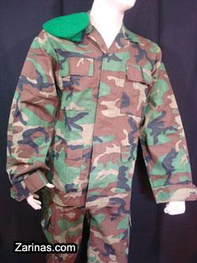
Afghanistan Army Uniform

Slide 9
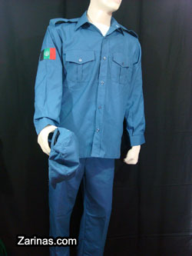
Afghanistan Police Uniform

Slide 10
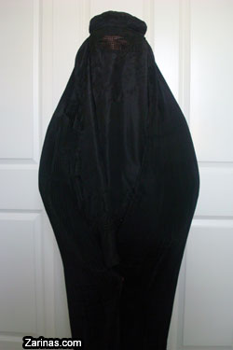
Burqa

Slide 11
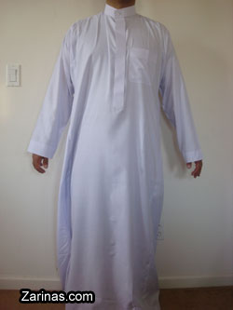
Dishadasha (Man Dress)

Slide 12
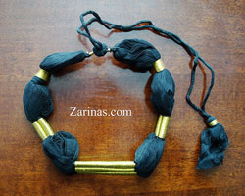
Egal

Slide 13
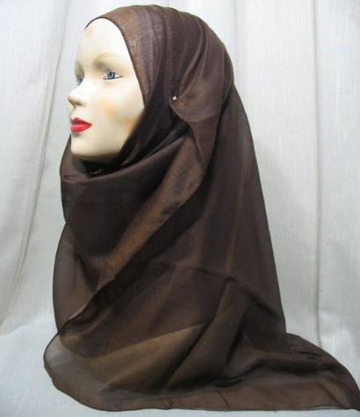
Hijab

Slide 14
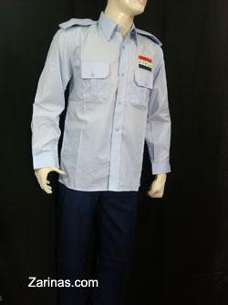
Iraqi Police Uniform

Slide 15
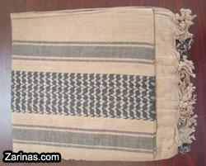
Kaffiyeh (Scarf)

Slide 16

Pakol

Slide 17

Shimagh (Head Scarf)

Slide 18
IED /Mines/ Ammunition

Slide 19
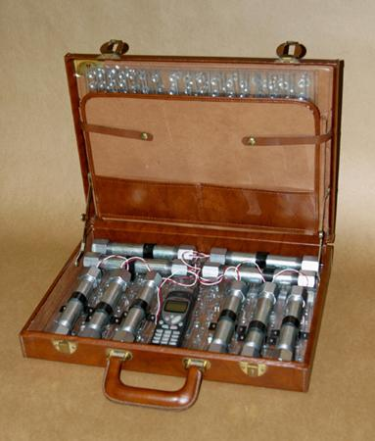
Briefcase Bomb

Slide 20
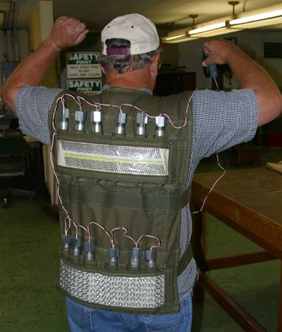
Suicide Bomb Vest

Slide 21
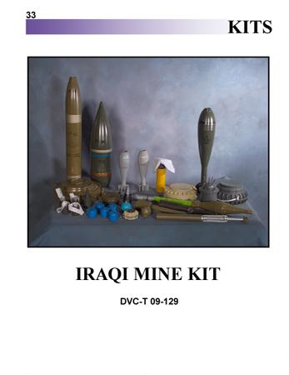
Iraqi Mine Kit

Slide 22
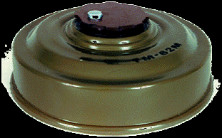
Land Mine

Slide 23

Mortar

Slide 24
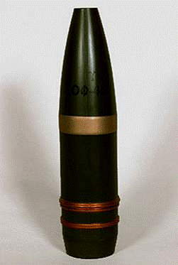


Projectile

Slide 25
Weapons

Slide 26
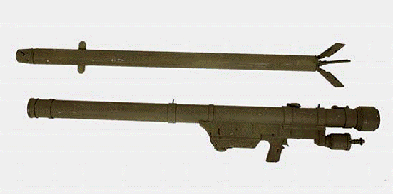
SA7 Grail

Slide 27
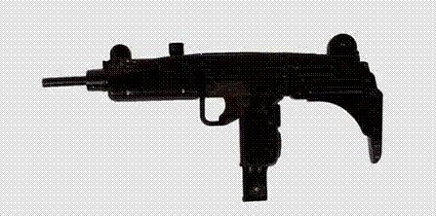
Uzi

Slide 28

Mini Uzi

Slide 29
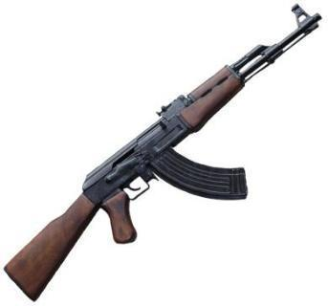
AK47

Slide 30
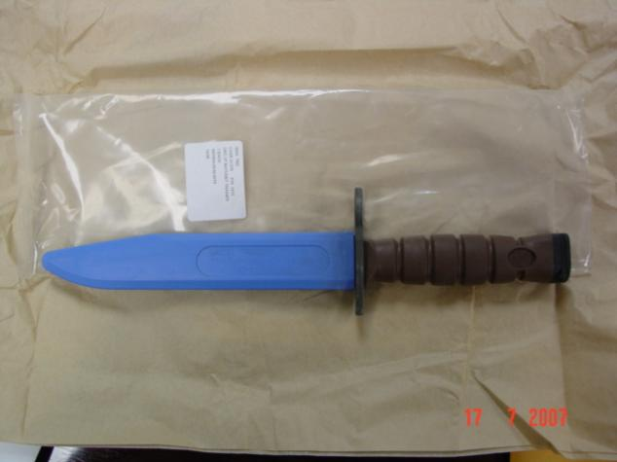
Kabar

Slide 31
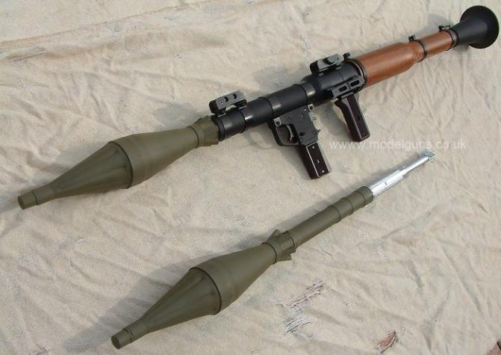
RPG

Slide 32
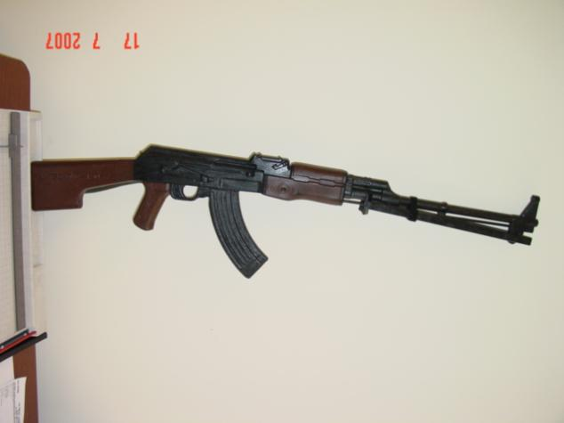
RPK

Slide 33
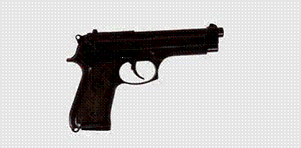
9mm Pistol

Slide 34

Silencer Pistol

Slide 35
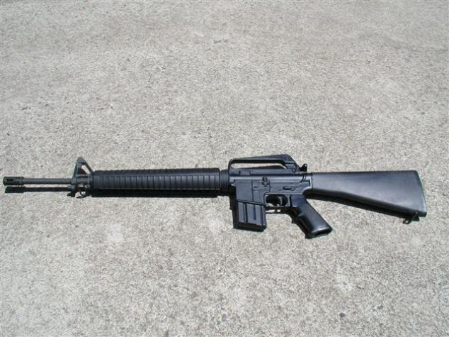
M16

Slide 36
Malice Kits

Slide 37
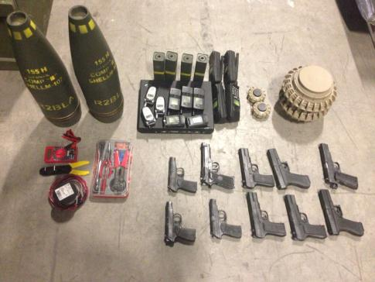
IED Kit

Slide 38
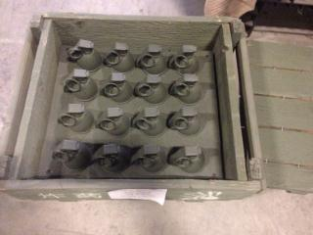
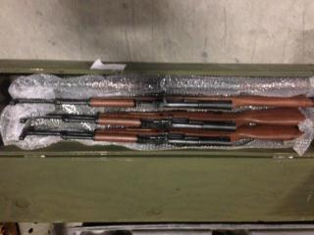
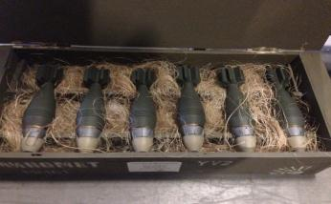
Weapons Cache

Slide 39
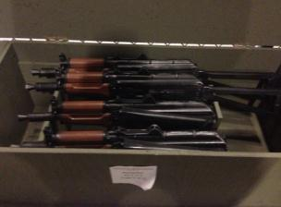
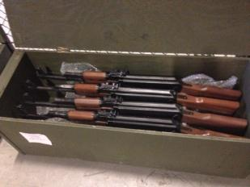
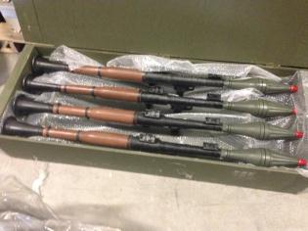
Weapons Cache

Slide 40
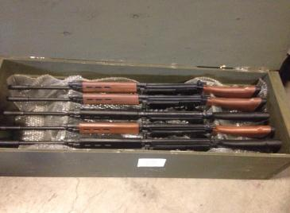
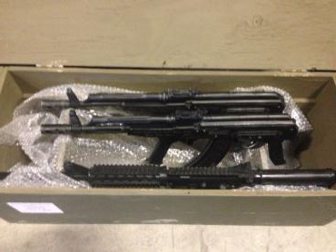
Weapons Cache

Slide 41
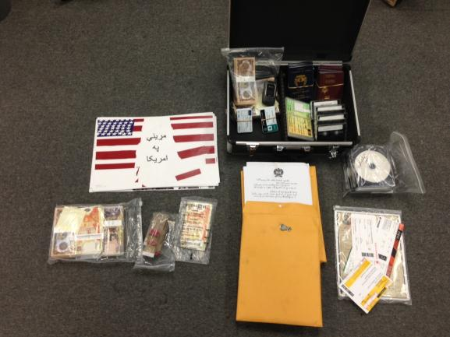
Travel Kit

Slide 42
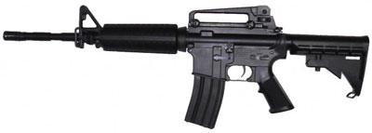
M4

Slide 43
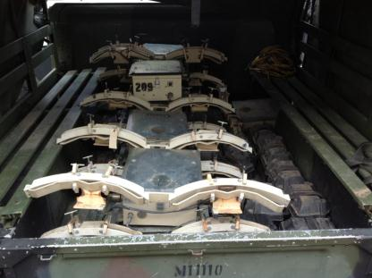
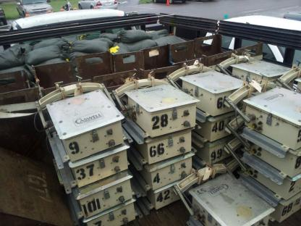
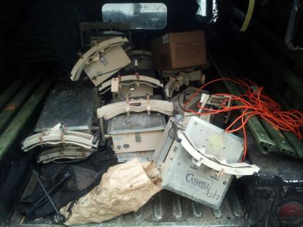
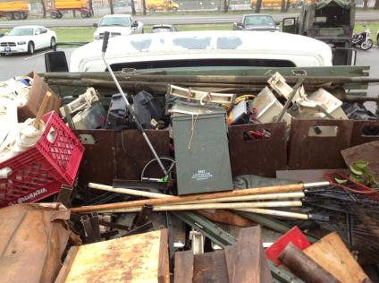
Proper Transportation
Improper Transportation

Slide 44
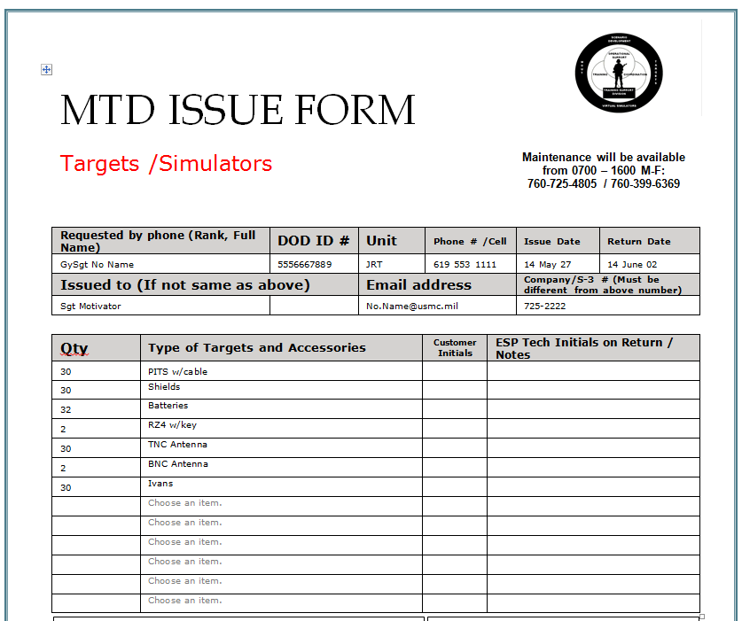
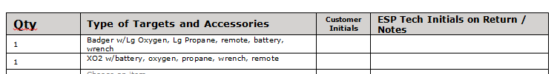
• One TNC antenna, battery, shield and
Ivan per PIT
• One Rz4 Remote per 15 targets
• One BNC antenna per remote
• One battery, remote oxygen and Propane tank will come with each simulator.
• Long issue may come with a charger unit if it is available

Slide 45
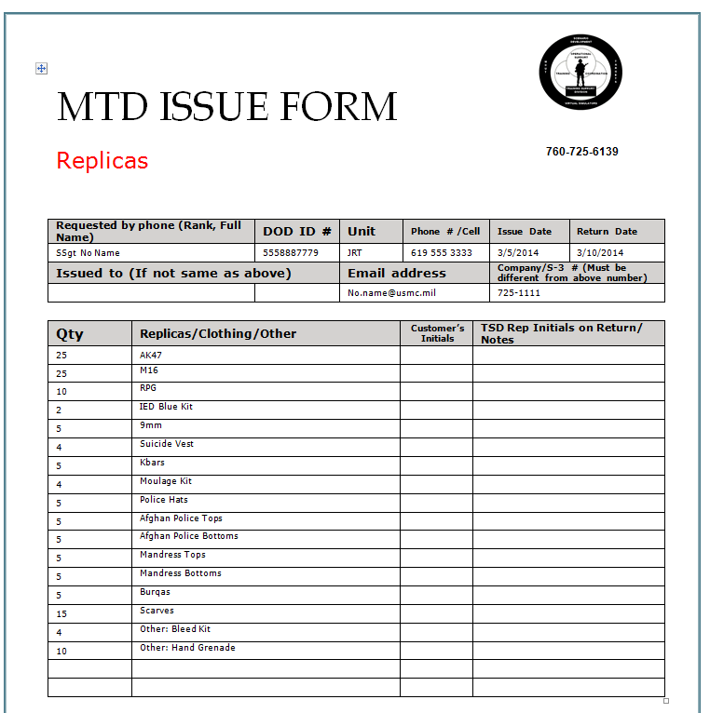

Slide 46
Building 2238
Phone: 760-725-6139
mcb_campen_tsd_trg_dev@nmci.usmc.mil

