Slide 1
Marine Corps Base Camp Pendleton
Resident Energy Conservation Program (RECP)
for
Lincoln Military Housing Residents

Slide 2
Purpose
Provide Housing Residents with information on the Resident Energy Conservation Program (RECP) and timeline for implementation aboard Marine Corps Base Camp Pendleton.
Notes:
2

Slide 3
Background
Office of the Secretary of Defense Memorandum of 8 September 1998 set policy for the payment of utilities in Public Private Venture (PPV) family housing.
Allows payment by resident for excess utilities utilization
PPV operating agreement includes this provision
Army started in 2003; Air Force in 2006

Slide 4
Background
HQMC approved implementation of the Resident Energy Conservation Program (RECP) at all PPV Projects - January 2012
RECP goals are consistent with DoD, DoN and USMC conservation principles
RECP Pilot Program has been running since Sep 2010
Navy conducted parallel pilot program in Hawaii
Concept was proven and refined

Slide 5
Background
Pilot Program approved by Commandant in 2010
Conducted at MCB Hawaii, MCRD Parris Island, and MCAS Beaufort from Sep 2010 to date
Mock Billing Sep - Dec 2010 and Live Billing began in Jan 2011
Electric Use & Costs dropped about 9%
No Impact on Resident Satisfaction and Occupancy
RECP Concept was Proven Successful
Lessons Learned applied moving forward

Slide 6
Resident Energy Conservation
Program (RECP)
RECP reduces electric costs, and saves funds for sustainment and improvements.
Cost savings generated by RECP will be used to improve homes, playgrounds, community centers, and quality of life
Helps protect our $2B investment in new housing and communities
Basic Allowance for Housing (BAH) is only expected to cover “normal” utilities use/costs, not excess.
Military Housing has traditionally used excess utilities
Most Families live off base and pay full utilities
12% of Camp Pendleton BAH is allocated all utility usage
Notes:
6

Slide 7
Resident Energy Conservation
Program (RECP)
Notes:
7

Slide 8
Resident Energy Conservation
Program (RECP)
RECP will encourage energy conservation
Residents using less energy will be rewarded with cash / credit
Residents using more energy will be billed for only the excess
Each Family can influence their own destiny
Notes:
8

Slide 9
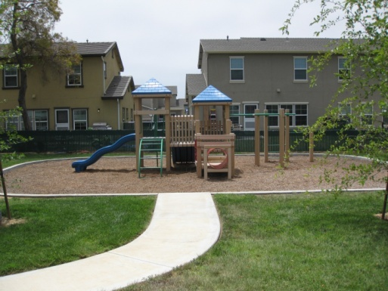
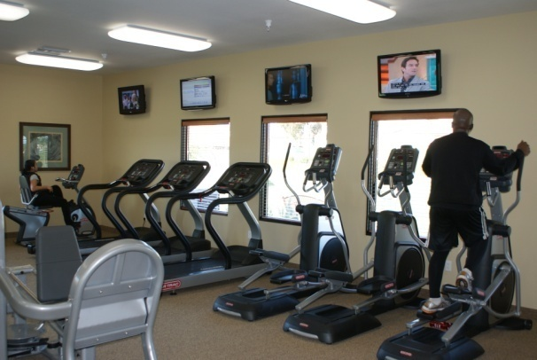
“Cost Savings = Improvements”
Notes:
9

Slide 10
RECP Program
Concept of Operations
Establish Housing Types
Based on location, size, style, age, number of bedrooms
Electric Metering
Lincoln Properties are 100% metered
Hunt Properties (Deluz) are 100% metered
Calculate Average Usage for each Type each Month
Top/bottom 5% not considered in average
Establish Average Range
Residents within +/- 10% of average have no cost impact
Residents outside range will get a refund or be billed for only excess not total
Notes:
10

Slide 11
RECP Program
Concept of Operations
Notional / Example Monthly Electric Usage
x
Example Individual
Resident Impacts
x
x
x
x
x
x
x
x
x
x
Bill for use over 110 kWh
Consumption (kWh)
x
x
x
x
x
x
x
No Credit and No Bill from 90 kWh to 110 kWh
x
x
x
x
x
x
x
x
Credit for use under 90 kWh
11 of 12
Spring Month
Notes:
11

Slide 12
RECP Program
Concept of Operations
Notional / Example Monthly Electric Usage
x
x
x
x
Example Individual
Resident Impacts
x
x
x
x
x
x
Bill for use over 121 kWh
x
x
Consumption (kWh)
Consumption (kWh)
x
x
No Credit and No Bill from 99 kWh to 121 kWh
x
x
x
x
Credit for use under 99 kWh
12 of 12
Summer Month
Notes:
12

Slide 13
RECP Program
Concept of Operations
Exemptions:
For some Wounded Warriors and Exceptional Family Members
Not used in calculation of monthly average
RECP will be implemented in two phases starting Calendar Year 2013
Phase I Housing Areas:
Deluz, Del Mar, San Mateo Point, San Onofre I/II/III, South Mesa I, Stuart Mesa II, Wire Mountain I/II and San Luis Rey
Phase II Housing Areas:
Del Mar (Koepler St), Forster Hills, O’Neill Heights, Pacific View, Santa Margarita, Serra Mesa, South Mesa II, Stuart Mesa, Wire Mountain III, and 14th Street
Notes:
13

Slide 14
RECP Program
Concept of Operations
Timelines are projected and subject to change
Before live billing begins:
Establish like-type housing groups
May - June 2012
RECP Leadership briefs
July - October 2012
CG MCIWEST-MCB CPEN Notification Letters and Program Information to Residents
September 2012
Phase II update July 2013
Publish Articles in Base Papers / Newsletters / Website
http://www.pendleton.marines.mil/Family/FamilyHousing/ResidentEnergyConservationProgram.aspx
October 2012
Updated July 2013
Notes:
14

Slide 15
RECP Program
Concept of Operations
PPV Partner Send Notification Letters to Residents
Phase I: October 2012
Phase II: July 2013
Town Hall Meetings / Energy Forums
Phase I: October 2012 – June 2013
Phase II: July 2013 – May 2014
Execute Lease Modifications
Phase I: September – December 2012
Phase II: January – December 2013
Notes:
15

Slide 16
RECP Program
Concept of Operations
PPV Partner sends 3-Month Mock Billing Notification Letters
Phase I: December 2012
Phase II: November 2013
PPV Partner sends Live Billing Notification Letters
Phase I: March 2013
Phase II: February 2013
Start Live Billing
Phase I: 1 April 2013
Phase II: 1 March 2014
Notes:
16

Slide 17
RECP Program
Concept of Operations
Government, PPV Partners and Third Party Vender monitor program
December 2012 - December 2014
RECP Expectations:
Electricity use will drop 12-15%, saving $2M per year
Savings will be used for family housing improvements
Most families will NOT be billed for utilities
Notes:
17

Slide 19
Who is YES Energy Management?
YES, or Yardi Energy Solutions, is the energy management division of Yardi, the makers of Voyager, the property management software used by Lincoln Military Housing.
YES Energy Management is the utility billing and energy management company of YES, with over 30 years of experience in the utility billing industry.
YES was the company selected to implement utility billing at Fort Carson, the first military base to implement this program in 2001.
Over 330 employees.
Current portfolio of 750,000+ units.
Over 55,000 units in the military portfolio.

Slide 20
Who is YES Energy Management?
YES, or Yardi Energy Solutions, is the energy management division of Yardi, the makers of Voyager, the property management software used by Lincoln Military Housing.
YES Energy Management is the utility billing and energy management company of YES, with over 30 years of experience in the utility billing industry.
YES was the company selected to implement utility billing at Fort Carson, the first military base to implement this program in 2001.
Over 330 employees.
Current portfolio of 750,000+ units.
Over 55,000 units in the military portfolio.

Slide 21
YES Energy Military Housing Experience
NAVY NORTH WEST
GREAT LAKES
HANSCOM AFB
LITTLE ROCK AFB
HILL AFB
FORT RILEY
ANDREWS AFB
QUANTICO
FORT CARSON
NAVY NORTH & SOUTH
NWS CHARLESTON
CAMP LEJUENE
LA AFB
FT STEWART/HUNTER
CAMP PENDLETON
NAVY KINGS BAY
DAVIS MONTHAN AFB
NAVY MAYPORT
HOLLOMAN AFB
MCLB
ALBANY
NAS JACKSONVILLE
ISLAND PALM COMMUNITIES
IROQUOIS POINT NAVY HAWAII
FORT BLISS
PATRICK AFB
WHITE SANDS
MISSILE RANGE
NAS
WHITING
FIELD
MACDILL AFB
LIBERTY VILLAGE
NAVY
MERIDIAN
NAS JRB FT WORTH
NAS
PENSACOLA
NAS KEY WEST
40+ Installations and growing
55,000+ Residents
70,000+ Hardware Units
Staff Field Technicians throughout the US
NAVY
GULFPORT
NAVY PANAMA CITY
NAS CORPUS CHRISTI

Slide 22
Did You Know ???
If you… | You will save enough energy to… | If 1,000 people joined, you could…
Use the microwave to cook 2 meals a week | Run your a/c for 1 hour | Power a local school for 2 days
Lower the thermostat on your water heater by 1 degree | Watch TV for 56 hours | Power a fire station for 39 weeks
Replaced 1 light bulb with a CFL | Surf the web for 214 hours | You could power a hospital for 3 days
Use the cold water cycle for 1 load of laundry | Recharge your laptop 17 times | Power a home for 30 days
Lower the heat by 1 degree in the winter | Watch 646 DVDs | Power 85,220 office computers for 1 year

Slide 23
YES Energy Advantages
Refund checks are mailed within 7 business days of the billing.
There is a Resident Portal.
Payments may be made on-line via the Portal, over the phone or by mail.
YES Energy Call Center = 24/7 support
Each base has a unique customer service phone number to reduce wait time.

Slide 24
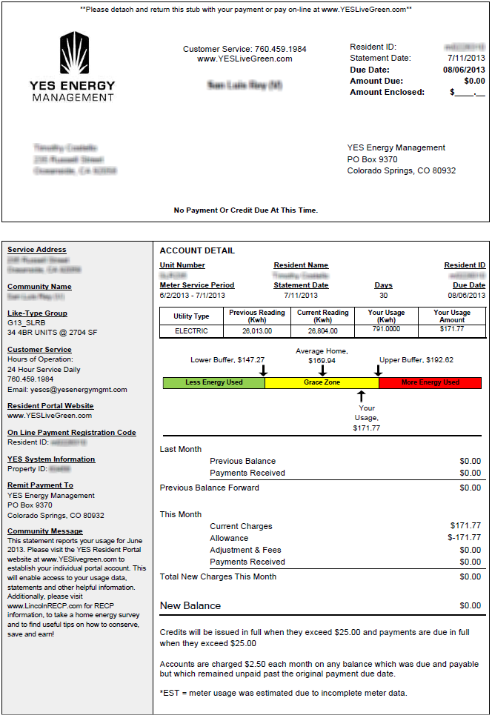
Statement (front)
Top portion of statement is the tear off stub with payment details.
Legend stating if there is an amount to pay, nothing to pay, or a refund check is due.
Left hand side contains:
Customer service contact details
Portal website address
Remit to address
Community Name
Resident ID and registration code
Main body lists:
Meter information
Utilities invoiced
Baseline and dollar charges / credits

Slide 25
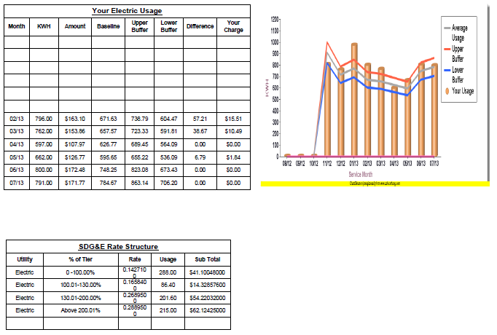
Statement (Graph and usage table in detail)
12-month your usage profile table:
Utility consumption
Baseline, including buffers
Dollar charges
12-month graph:
Residence consumption
Like type unit baseline
Normal Usage Buffer Zone of +/- 10%
Utility Rate Table:
kWh tier breakdown
Rates per tier
Usage per tier
Sub-totals per tier

Slide 26
Resident Portal
Secure website Featuring:
Your current and past utility statements
View current and projected consumption
Review utility account balance
Make a payment
Conservation tips
FAQ’s on the USMC RECP Program
Resident Portal address: www.YESLiveGreen.com

Slide 27
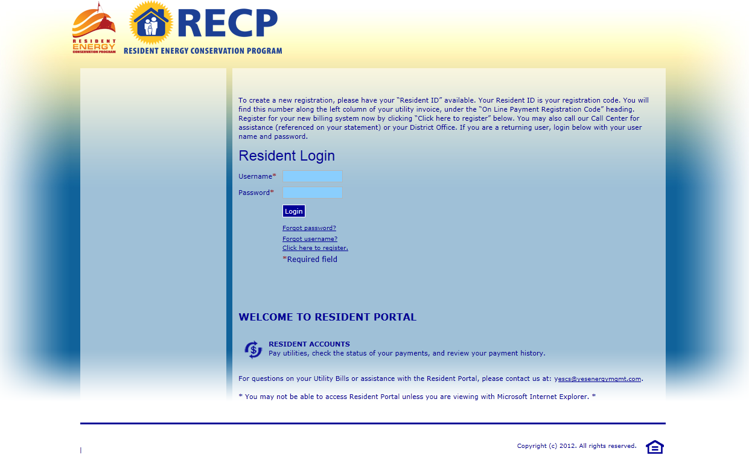
Resident Portal – login screen
Resident Portal address: www.YESLiveGreen.com

Slide 28
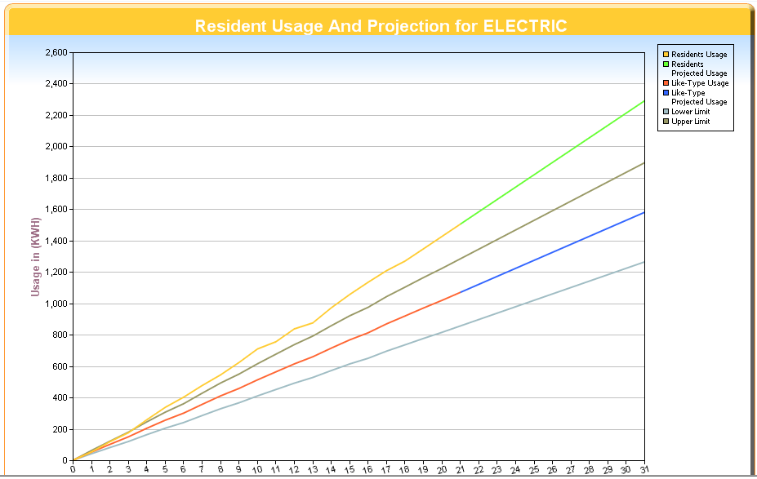
Monthly and Projected Usage Graphs
Reviewing past & projected consumption and cost
Date driven
Current date for projected consumption & cost
Prior date for historic consumption & cost
Red line = baseline to date
Blue line = projected baseline
Brown line = baseline upper threshold
Grey line = baseline lower threshold
Yellow line = Your consumption to date
Green line = Your projected consumption

Slide 29
YES Energy Customer Service
24/7 call center
Unique customer service number automatically identifies your base
Payments can be made over the phone
Portal log in assistance if you need to reset your password
Billing questions
English and Spanish greeting options
English and Spanish speaking representatives

Slide 30
Points of Contact
For billing questions, please contact YES Energy at:
(855) 808-9123 or yescs@yesenergymgmt.com

Slide 31
Useful Links and Information
2013 Basic Allowance for Housing Component Breakdown:
http://www.defensetravel.dod.mil/Docs/perdiem/browse/Allowances/BAH/Component_Breakdown/2013-BAH-Rate-Component-Breakdown.pdf
MCB CAMPEN Family Housing RECP Information Site
http://www.pendleton.marines.mil/Family/FamilyHousing/ResidentEnergyConservationProgram.aspx
PAO published articles and information
http://www.pendleton.marines.mil/Family/FamilyHousing/ResidentEnergyConservationProgram.aspx
YES Resident Portal address:
www.YESLiveGreen.com
(855) 808-9123 or yescs@yesenergymgmt.com
Lincoln Military Housing:
http://www.lincolnmilitary.com/camppendleton/

