Slide 1
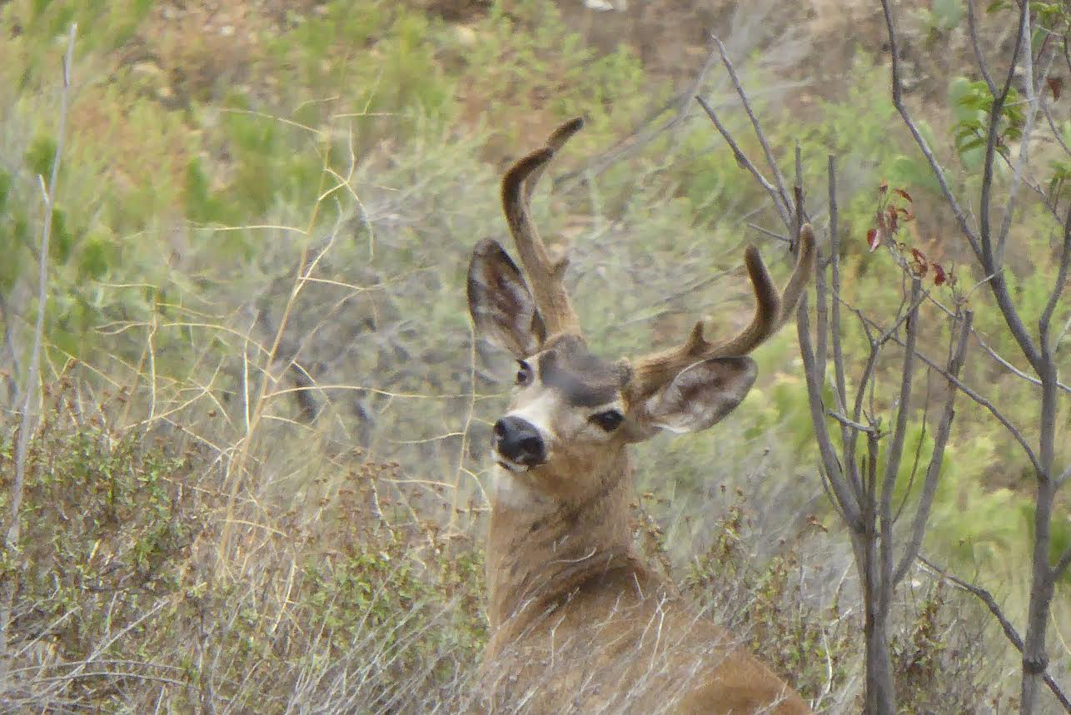
A (mostly) non-invasive genetics approach to monitoring connectivity in the Southern Mule Deer of San Diego County
Photo credit: John Kiss
Anna Mitelberg¹, Amy Vandergast¹, Andrew Bohonak²
¹ WERC, USGS; ² SDSU
Notes:
The purpose of my talk today is to describe a long term cumulative approach that we have taken here in San Diego Country to monitoring genetic connectivity for our small population of Southern mule deer, living in the midst of our highly fragmented landscape.

Slide 2

Figure 6. Estimated California Population, 1912 to 2013
Webb, 2016
Notes:
While in some parts of the world deer can become a nuisance, deer populations in western US are on the decline. This pattern is especially strong in California, where populations have plummeted from over 2 million in 1950s, to less than half a million in 2012. The most likely cause of this is habitat loss and fragmentation.

Slide 3
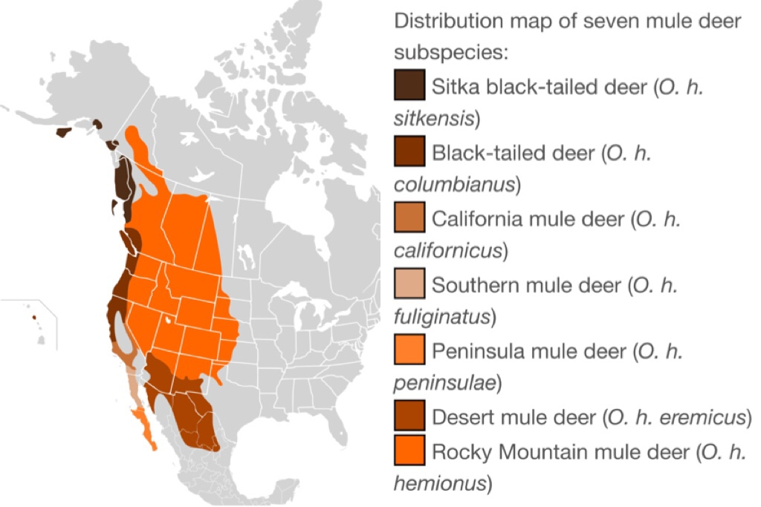
Odocoileus hemionus fuliginatus
Notes:
There are 5-6 recognized subspecies of deer in California. The deer in San Diego belong to the subspecies Odocoileus hemionus fuliginatus, common name Southern mule deer.
The Southern mule deer range extends from Southern California into Baja.

Slide 4
Pease et al. 2009
Notes:
A range-wide genetic study of mule deer in California found the San Diego genetic group formed their own genetically unique cluster distinct from the 4 clusters in the state and distinct genetically, even from other Southern mule deer.

Slide 5
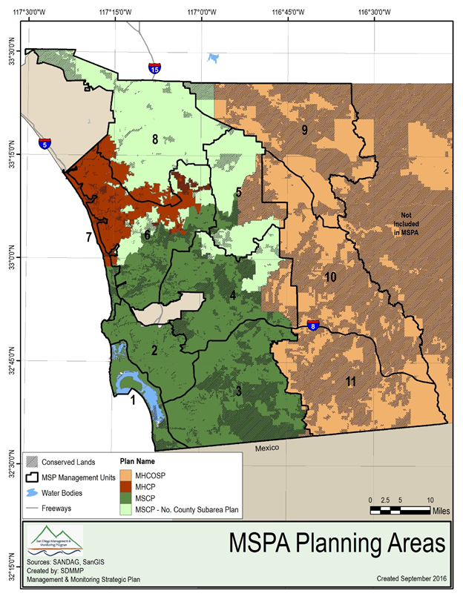
“Although not considered sensitive, this broadly distributed species has aesthetic and intrinsic values, and is the only large native herbivore in the plan area thereby making it an important species to protect. The criteria used to define core and linkage areas involves maintaining ecosystem function and processes, including large animal movement.” -MSCP
Notes:
The Southern mule deer is a monitored species in the SD Multi-species conservation plan, as well as the North County plan; and connectivity among individual preserves within the highly urbanized preserves is of primary concern for this species. “Although not considered sensitive, this broadly distributed species has aesthetic and intrinsic values, and is the only large native herbivore in the plan area thereby making it an important species to protect. The criteria used to define core and linkage areas involves maintaining ecosystem function and processes, including large animal movement.”
Each core area is connected to other core areas or to habitat areas outside of the MSCP either through common boundaries or through linkages. Core areas have multiple connections to help ensure that the balance in the ecosystem will be maintained. An extensive monitoring program will also be implemented by the wildlife agencies to delete unanticipated changes in ecosystem function and allow for adaptive management of the preserve system.
Specific design criteria for linkages, road crossings/undercrossings are included in the Subarea Plans.

Slide 6
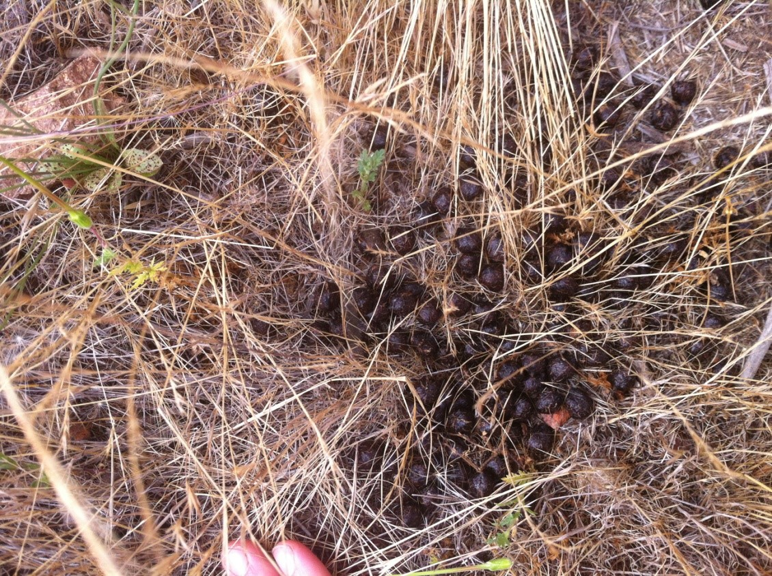
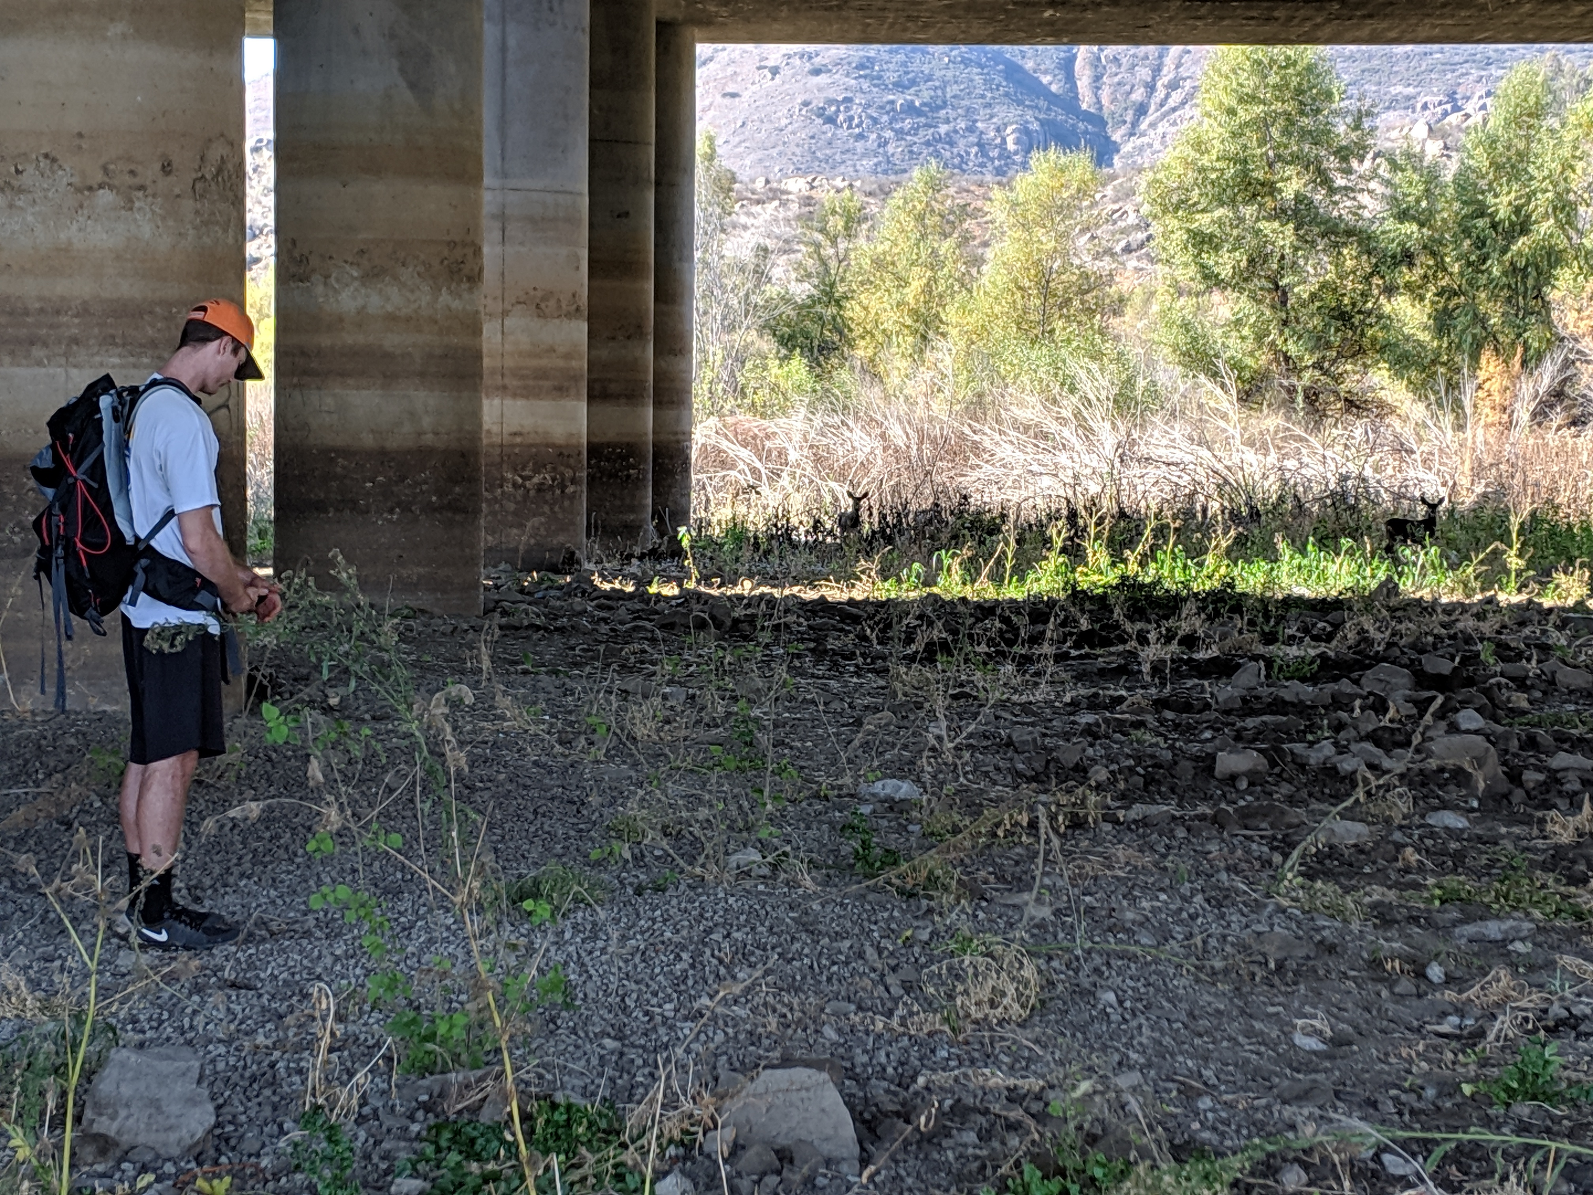
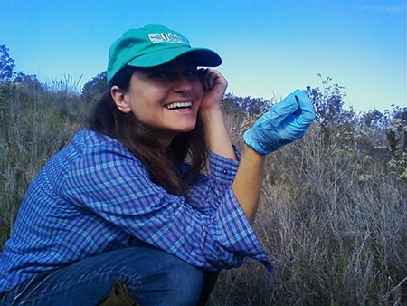

Notes:
Until recently, we have used only non-invasive genetic methods for monitoring this species in San Diego County. Sampling involved arriving at sites where deer presence was previously confirmed or suspected. Upon arriving at the site we searched for fresh deer sign such as tracks or browse and we would then track until we encountered fresh scat piles. These were then brought into the lab, extracted and genotyped.
This method works well for us. Deer are large and elusive animal, that are difficult to capture and as I hope you will see from this talk, there’s a ton of information that can be extracted from the genetic data.
For measuring connectivity, it can serve as a complementary method to measuring direct movement using camera traps and other other mark-resighting methods, which are used for measuring direct movement.

Slide 7
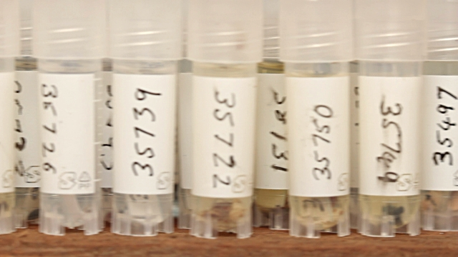
15 microsat loci
+
gender
~40% scat piles = DNA fingerprint
1272
Scat
Piles
359
Deer
69 Tissue Samples
~100% tissue samples = DNA fingerprint
Notes:
As part of this project since 2005, 1272 deer scat piles have been extracted and DNA fingerprinted. Last year we were lucky enough to get 69 tissue samples from the 2018 harvest at Camp Pendleton. To date, we have a data set consisting of 359 unique deer. The one disadvantage of non-invasive collection is that only about ~40% of scat piles yield DNA of high enough quality for genetic analyses, in contrast to 100% of tissue samples.

Slide 8
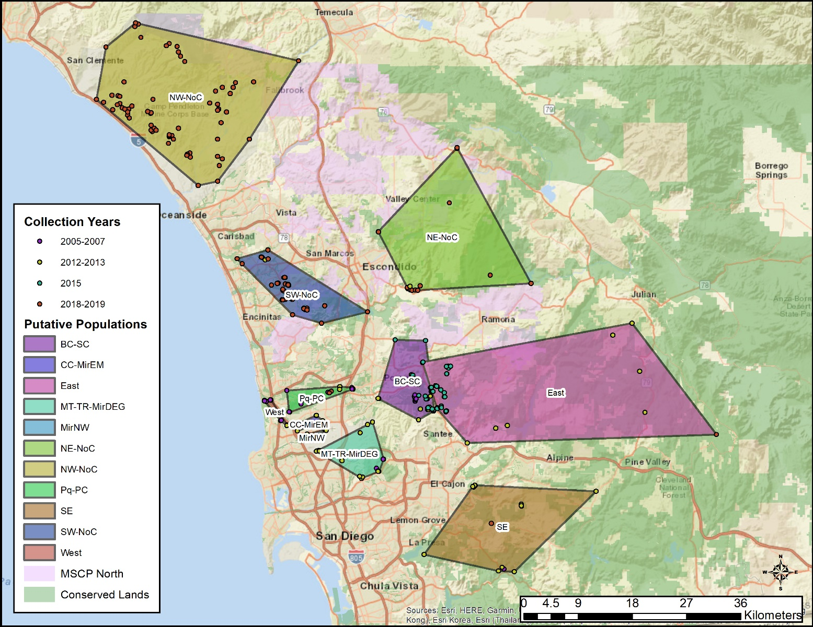
Notes:
These samples have been collected essentially in 4 phases. The first two phases mostly looked at connectivity in urbanized San Diego, but also included some samples in less developed areas to the east. The third phase expanded the sample size for east county and focused on sampling around SR67. This fourth phase (2018-19) looked at connectivity in north county, including samples from Camp Pendleton.

Slide 9
Notes:
2018-2019 Samples, zoomed in and grouped into 3 geographic sampling regions.

Slide 10
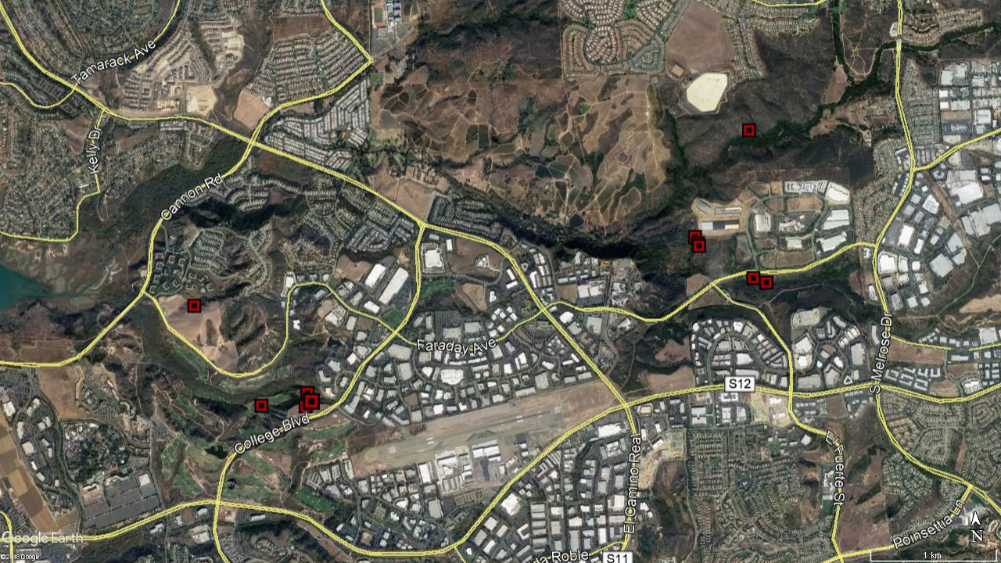
Direct Capture-Recapture
Mule Deer | Date Collected | Site | Scat Pile | Gender | Locus B |  | Locus C |  | Locus D |  | Locus G |  | Locus H |  | Locus J |  | Locus K |  | Locus L |  | Locus M |  | Locus N |  | Locus P |  | Locus R |  | Locus S |  | Locus V
MDn190 | 5/11/2018 | SE Road | SPn190 | f | 153 | 153 | 327 | 327 | 170 | 182 | 330 | 330 | 349 | 349 | 242 | 242 | 197 | 205 | 292 | 296 | 142 | 154 | 306 | 314 | 231 | 231 | 288 | 292 | 207 | 209 | 84 | 84
MDn190 | 5/21/2018 | SM Creek | SPn338 | f | 153 | 153 | 327 | 327 | 170 | 182 | 330 | 330 | 349 | 349 | 242 | 242 | 197 | 205 | 292 | 296 | 142 | 154 | 306 | 314 | 231 | 231 | 288 | 292 | 207 | 209 | 84 | 84
MDn195 | 5/15/2018 | Veterans | SPn195 | m | 153 | 153 | 319 | 319 | 162 | 174 | 318 | 330 | 349 | 353 | 242 | 242 | 205 | 205 | 260 | 296 | 142 | 146 | 294 | 314 | 223 | 231 | 264 | 292 | 203 | 209 | 84 | 84
MDn195 | 5/29/2018 | S Faraday | SPn355 | m | 153 | 153 | 319 | 319 | 162 | 174 | 318 | 330 | 349 | 353 | 242 | 242 | 205 | 205 | 260 | 296 | 142 | 146 | 294 | 314 | 223 | 231 | 264 | 292 | 203 | 209 | 84 | 84
MDn195 | 5/29/2018 | S Faraday | SPn360 | m | 153 | 153 | 319 | 319 | 162 | 174 | 318 | 330 | 349 | 353 | 242 | 242 | 205 | 205 | 260 | 296 | 142 | 146 | 294 | 314 | 223 | 231 | 264 | 292 | 203 | 209 | 84 | 84
MDn195 | 5/31/2018 | N Faraday | SPn384 | m | 153 | 153 | 319 | 319 | 162 | 174 | 318 | 330 | 349 | 353 | 242 | 242 | 205 | 205 | 260 | 296 | 142 | 146 | 294 | 314 | 223 | 231 | 264 | 292 | 203 | 209 | 84 | 84
MDn195 | 5/31/2018 | N Faraday | SPn401 | m | 153 | 153 | 319 | 319 | 162 | 174 | 318 | 330 | 349 | 353 | 242 | 242 | 205 | 205 | 260 | 296 | 142 | 146 | 294 | 314 | 223 | 231 | 264 | 292 | 203 | 209 | 84 | 84
MDn195 | 5/31/2018 | N Faraday | SPn415 | m | 153 | 153 | 319 | 319 | 162 | 174 | 318 | 330 | 349 | 353 | 242 | 242 | 205 | 205 | 260 | 296 | 142 | 146 | 294 | 314 | 223 | 231 | 264 | 292 | 203 | 209 | 84 | 84
MDn195 | 6/5/2018 | Crossings | SPn430 | m | 153 | 153 | 319 | 319 | 162 | 174 | 318 | 330 | 349 | 353 | 242 | 242 | 205 | 205 | 260 | 296 | 142 | 146 | 294 | 314 | 223 | 231 | 264 | 292 | 203 | 209 | 84 | 84
MDn195 | 6/5/2018 | Crossings | SPn432 | m | 153 | 153 | 319 | 319 | 162 | 174 | 318 | 330 | 349 | 353 | 242 | 242 | 205 | 205 | 260 | 296 | 142 | 146 | 294 | 314 | 223 | 231 | 264 | 292 | 203 | 209 | 84 | 84
MDn195 | 6/5/2018 | Crossings | SPn435 | m | 153 | 153 | 319 | 319 | 162 | 174 | 318 | 330 | 349 | 353 | 242 | 242 | 205 | 205 | 260 | 296 | 142 | 146 | 294 | 314 | 223 | 231 | 264 | 292 | 203 | 209 | 84 | 84
MDn195 | 6/5/2018 | Crossings | SPn436 | m | 153 | 153 | 319 | 319 | 162 | 174 | 318 | 330 | 349 | 353 | 242 | 242 | 205 | 205 | 260 | 296 | 142 | 146 | 294 | 314 | 223 | 231 | 264 | 292 | 203 | 209 | 84 | 84
MDn195 | 6/10/2018 | Los Monos | SPn446 | m | 153 | 153 | 319 | 319 | 162 | 174 | 318 | 330 | 349 | 353 | 242 | 242 | 205 | 205 | 260 | 296 | 142 | 146 | 294 | 314 | 223 | 231 | 264 | 292 | 203 | 209 | 84 | 84
EW2-9
M5-2b
M5-2a
Notes:
What kind of information can we get from non-invasive data?
We can infer recent movement of animals through the landscape using direct capture-recapture methods. Here is an example of some scat piles and their genetic fingerprints. Here, the loci at the top are just names for sites of interest in the genetic code of each individual, and we ended up looking at 15 sites plus a site for gender in the DNA of each individual. At each site in the DNA, each individual is going to inherit one copy of the genetic code at that site from each parent (which is why each site that we are looking at has 2 numbers – and the numbers here are just names for different versions of the genetic information at that site). So for example, looking at the raw data, we can see we have several scat piles here with the same genetic fingerprint.

Slide 11
Direct Capture-Recapture
Mule Deer | Date Collected | Site | Scat Pile | Gender | Locus B |  | Locus C |  | Locus D |  | Locus G |  | Locus H |  | Locus J |  | Locus K |  | Locus L |  | Locus M |  | Locus N |  | Locus P |  | Locus R |  | Locus S |  | Locus V
MDn190 | 5/11/2018 | SE Road | SPn190 | f | 153 | 153 | 327 | 327 | 170 | 182 | 330 | 330 | 349 | 349 | 242 | 242 | 197 | 205 | 292 | 296 | 142 | 154 | 306 | 314 | 231 | 231 | 288 | 292 | 207 | 209 | 84 | 84
MDn190 | 5/21/2018 | SM Creek | SPn338 | f | 153 | 153 | 327 | 327 | 170 | 182 | 330 | 330 | 349 | 349 | 242 | 242 | 197 | 205 | 292 | 296 | 142 | 154 | 306 | 314 | 231 | 231 | 288 | 292 | 207 | 209 | 84 | 84
MDn195 | 5/15/2018 | Veterans | SPn195 | m | 153 | 153 | 319 | 319 | 162 | 174 | 318 | 330 | 349 | 353 | 242 | 242 | 205 | 205 | 260 | 296 | 142 | 146 | 294 | 314 | 223 | 231 | 264 | 292 | 203 | 209 | 84 | 84
MDn195 | 5/29/2018 | S Faraday | SPn355 | m | 153 | 153 | 319 | 319 | 162 | 174 | 318 | 330 | 349 | 353 | 242 | 242 | 205 | 205 | 260 | 296 | 142 | 146 | 294 | 314 | 223 | 231 | 264 | 292 | 203 | 209 | 84 | 84
MDn195 | 5/29/2018 | S Faraday | SPn360 | m | 153 | 153 | 319 | 319 | 162 | 174 | 318 | 330 | 349 | 353 | 242 | 242 | 205 | 205 | 260 | 296 | 142 | 146 | 294 | 314 | 223 | 231 | 264 | 292 | 203 | 209 | 84 | 84
MDn195 | 5/31/2018 | N Faraday | SPn384 | m | 153 | 153 | 319 | 319 | 162 | 174 | 318 | 330 | 349 | 353 | 242 | 242 | 205 | 205 | 260 | 296 | 142 | 146 | 294 | 314 | 223 | 231 | 264 | 292 | 203 | 209 | 84 | 84
MDn195 | 5/31/2018 | N Faraday | SPn401 | m | 153 | 153 | 319 | 319 | 162 | 174 | 318 | 330 | 349 | 353 | 242 | 242 | 205 | 205 | 260 | 296 | 142 | 146 | 294 | 314 | 223 | 231 | 264 | 292 | 203 | 209 | 84 | 84
MDn195 | 5/31/2018 | N Faraday | SPn415 | m | 153 | 153 | 319 | 319 | 162 | 174 | 318 | 330 | 349 | 353 | 242 | 242 | 205 | 205 | 260 | 296 | 142 | 146 | 294 | 314 | 223 | 231 | 264 | 292 | 203 | 209 | 84 | 84
MDn195 | 6/5/2018 | Crossings | SPn430 | m | 153 | 153 | 319 | 319 | 162 | 174 | 318 | 330 | 349 | 353 | 242 | 242 | 205 | 205 | 260 | 296 | 142 | 146 | 294 | 314 | 223 | 231 | 264 | 292 | 203 | 209 | 84 | 84
MDn195 | 6/5/2018 | Crossings | SPn432 | m | 153 | 153 | 319 | 319 | 162 | 174 | 318 | 330 | 349 | 353 | 242 | 242 | 205 | 205 | 260 | 296 | 142 | 146 | 294 | 314 | 223 | 231 | 264 | 292 | 203 | 209 | 84 | 84
MDn195 | 6/5/2018 | Crossings | SPn435 | m | 153 | 153 | 319 | 319 | 162 | 174 | 318 | 330 | 349 | 353 | 242 | 242 | 205 | 205 | 260 | 296 | 142 | 146 | 294 | 314 | 223 | 231 | 264 | 292 | 203 | 209 | 84 | 84
MDn195 | 6/5/2018 | Crossings | SPn436 | m | 153 | 153 | 319 | 319 | 162 | 174 | 318 | 330 | 349 | 353 | 242 | 242 | 205 | 205 | 260 | 296 | 142 | 146 | 294 | 314 | 223 | 231 | 264 | 292 | 203 | 209 | 84 | 84
MDn195 | 6/10/2018 | Los Monos | SPn446 | m | 153 | 153 | 319 | 319 | 162 | 174 | 318 | 330 | 349 | 353 | 242 | 242 | 205 | 205 | 260 | 296 | 142 | 146 | 294 | 314 | 223 | 231 | 264 | 292 | 203 | 209 | 84 | 84
EW2-9
M5-2b
M5-2a
Notes:
Here, at Locus B, you can see all these scat piles have the same version of the gene that they inherited from each parent

Slide 12
Direct Capture-Recapture
Mule Deer | Date Collected | Site | Scat Pile | Gender | Locus B |  | Locus C |  | Locus D |  | Locus G |  | Locus H |  | Locus J |  | Locus K |  | Locus L |  | Locus M |  | Locus N |  | Locus P |  | Locus R |  | Locus S |  | Locus V
MDn190 | 5/11/2018 | SE Road | SPn190 | f | 153 | 153 | 327 | 327 | 170 | 182 | 330 | 330 | 349 | 349 | 242 | 242 | 197 | 205 | 292 | 296 | 142 | 154 | 306 | 314 | 231 | 231 | 288 | 292 | 207 | 209 | 84 | 84
MDn190 | 5/21/2018 | SM Creek | SPn338 | f | 153 | 153 | 327 | 327 | 170 | 182 | 330 | 330 | 349 | 349 | 242 | 242 | 197 | 205 | 292 | 296 | 142 | 154 | 306 | 314 | 231 | 231 | 288 | 292 | 207 | 209 | 84 | 84
MDn195 | 5/15/2018 | Veterans | SPn195 | m | 153 | 153 | 319 | 319 | 162 | 174 | 318 | 330 | 349 | 353 | 242 | 242 | 205 | 205 | 260 | 296 | 142 | 146 | 294 | 314 | 223 | 231 | 264 | 292 | 203 | 209 | 84 | 84
MDn195 | 5/29/2018 | S Faraday | SPn355 | m | 153 | 153 | 319 | 319 | 162 | 174 | 318 | 330 | 349 | 353 | 242 | 242 | 205 | 205 | 260 | 296 | 142 | 146 | 294 | 314 | 223 | 231 | 264 | 292 | 203 | 209 | 84 | 84
MDn195 | 5/29/2018 | S Faraday | SPn360 | m | 153 | 153 | 319 | 319 | 162 | 174 | 318 | 330 | 349 | 353 | 242 | 242 | 205 | 205 | 260 | 296 | 142 | 146 | 294 | 314 | 223 | 231 | 264 | 292 | 203 | 209 | 84 | 84
MDn195 | 5/31/2018 | N Faraday | SPn384 | m | 153 | 153 | 319 | 319 | 162 | 174 | 318 | 330 | 349 | 353 | 242 | 242 | 205 | 205 | 260 | 296 | 142 | 146 | 294 | 314 | 223 | 231 | 264 | 292 | 203 | 209 | 84 | 84
MDn195 | 5/31/2018 | N Faraday | SPn401 | m | 153 | 153 | 319 | 319 | 162 | 174 | 318 | 330 | 349 | 353 | 242 | 242 | 205 | 205 | 260 | 296 | 142 | 146 | 294 | 314 | 223 | 231 | 264 | 292 | 203 | 209 | 84 | 84
MDn195 | 5/31/2018 | N Faraday | SPn415 | m | 153 | 153 | 319 | 319 | 162 | 174 | 318 | 330 | 349 | 353 | 242 | 242 | 205 | 205 | 260 | 296 | 142 | 146 | 294 | 314 | 223 | 231 | 264 | 292 | 203 | 209 | 84 | 84
MDn195 | 6/5/2018 | Crossings | SPn430 | m | 153 | 153 | 319 | 319 | 162 | 174 | 318 | 330 | 349 | 353 | 242 | 242 | 205 | 205 | 260 | 296 | 142 | 146 | 294 | 314 | 223 | 231 | 264 | 292 | 203 | 209 | 84 | 84
MDn195 | 6/5/2018 | Crossings | SPn432 | m | 153 | 153 | 319 | 319 | 162 | 174 | 318 | 330 | 349 | 353 | 242 | 242 | 205 | 205 | 260 | 296 | 142 | 146 | 294 | 314 | 223 | 231 | 264 | 292 | 203 | 209 | 84 | 84
MDn195 | 6/5/2018 | Crossings | SPn435 | m | 153 | 153 | 319 | 319 | 162 | 174 | 318 | 330 | 349 | 353 | 242 | 242 | 205 | 205 | 260 | 296 | 142 | 146 | 294 | 314 | 223 | 231 | 264 | 292 | 203 | 209 | 84 | 84
MDn195 | 6/5/2018 | Crossings | SPn436 | m | 153 | 153 | 319 | 319 | 162 | 174 | 318 | 330 | 349 | 353 | 242 | 242 | 205 | 205 | 260 | 296 | 142 | 146 | 294 | 314 | 223 | 231 | 264 | 292 | 203 | 209 | 84 | 84
MDn195 | 6/10/2018 | Los Monos | SPn446 | m | 153 | 153 | 319 | 319 | 162 | 174 | 318 | 330 | 349 | 353 | 242 | 242 | 205 | 205 | 260 | 296 | 142 | 146 | 294 | 314 | 223 | 231 | 264 | 292 | 203 | 209 | 84 | 84
EW2-9
M5-2b
M5-2a
Notes:
At Locus C, you can see that the top 2 scat piles, have different versions of the gene than the rest.

Slide 13
Direct Capture-Recapture
Mule Deer | Date Collected | Site | Scat Pile | Gender | Locus B |  | Locus C |  | Locus D |  | Locus G |  | Locus H |  | Locus J |  | Locus K |  | Locus L |  | Locus M |  | Locus N |  | Locus P |  | Locus R |  | Locus S |  | Locus V
MDn190 | 5/11/2018 | SE Road | SPn190 | f | 153 | 153 | 327 | 327 | 170 | 182 | 330 | 330 | 349 | 349 | 242 | 242 | 197 | 205 | 292 | 296 | 142 | 154 | 306 | 314 | 231 | 231 | 288 | 292 | 207 | 209 | 84 | 84
MDn190 | 5/21/2018 | SM Creek | SPn338 | f | 153 | 153 | 327 | 327 | 170 | 182 | 330 | 330 | 349 | 349 | 242 | 242 | 197 | 205 | 292 | 296 | 142 | 154 | 306 | 314 | 231 | 231 | 288 | 292 | 207 | 209 | 84 | 84
MDn195 | 5/15/2018 | Veterans | SPn195 | m | 153 | 153 | 319 | 319 | 162 | 174 | 318 | 330 | 349 | 353 | 242 | 242 | 205 | 205 | 260 | 296 | 142 | 146 | 294 | 314 | 223 | 231 | 264 | 292 | 203 | 209 | 84 | 84
MDn195 | 5/29/2018 | S Faraday | SPn355 | m | 153 | 153 | 319 | 319 | 162 | 174 | 318 | 330 | 349 | 353 | 242 | 242 | 205 | 205 | 260 | 296 | 142 | 146 | 294 | 314 | 223 | 231 | 264 | 292 | 203 | 209 | 84 | 84
MDn195 | 5/29/2018 | S Faraday | SPn360 | m | 153 | 153 | 319 | 319 | 162 | 174 | 318 | 330 | 349 | 353 | 242 | 242 | 205 | 205 | 260 | 296 | 142 | 146 | 294 | 314 | 223 | 231 | 264 | 292 | 203 | 209 | 84 | 84
MDn195 | 5/31/2018 | N Faraday | SPn384 | m | 153 | 153 | 319 | 319 | 162 | 174 | 318 | 330 | 349 | 353 | 242 | 242 | 205 | 205 | 260 | 296 | 142 | 146 | 294 | 314 | 223 | 231 | 264 | 292 | 203 | 209 | 84 | 84
MDn195 | 5/31/2018 | N Faraday | SPn401 | m | 153 | 153 | 319 | 319 | 162 | 174 | 318 | 330 | 349 | 353 | 242 | 242 | 205 | 205 | 260 | 296 | 142 | 146 | 294 | 314 | 223 | 231 | 264 | 292 | 203 | 209 | 84 | 84
MDn195 | 5/31/2018 | N Faraday | SPn415 | m | 153 | 153 | 319 | 319 | 162 | 174 | 318 | 330 | 349 | 353 | 242 | 242 | 205 | 205 | 260 | 296 | 142 | 146 | 294 | 314 | 223 | 231 | 264 | 292 | 203 | 209 | 84 | 84
MDn195 | 6/5/2018 | Crossings | SPn430 | m | 153 | 153 | 319 | 319 | 162 | 174 | 318 | 330 | 349 | 353 | 242 | 242 | 205 | 205 | 260 | 296 | 142 | 146 | 294 | 314 | 223 | 231 | 264 | 292 | 203 | 209 | 84 | 84
MDn195 | 6/5/2018 | Crossings | SPn432 | m | 153 | 153 | 319 | 319 | 162 | 174 | 318 | 330 | 349 | 353 | 242 | 242 | 205 | 205 | 260 | 296 | 142 | 146 | 294 | 314 | 223 | 231 | 264 | 292 | 203 | 209 | 84 | 84
MDn195 | 6/5/2018 | Crossings | SPn435 | m | 153 | 153 | 319 | 319 | 162 | 174 | 318 | 330 | 349 | 353 | 242 | 242 | 205 | 205 | 260 | 296 | 142 | 146 | 294 | 314 | 223 | 231 | 264 | 292 | 203 | 209 | 84 | 84
MDn195 | 6/5/2018 | Crossings | SPn436 | m | 153 | 153 | 319 | 319 | 162 | 174 | 318 | 330 | 349 | 353 | 242 | 242 | 205 | 205 | 260 | 296 | 142 | 146 | 294 | 314 | 223 | 231 | 264 | 292 | 203 | 209 | 84 | 84
MDn195 | 6/10/2018 | Los Monos | SPn446 | m | 153 | 153 | 319 | 319 | 162 | 174 | 318 | 330 | 349 | 353 | 242 | 242 | 205 | 205 | 260 | 296 | 142 | 146 | 294 | 314 | 223 | 231 | 264 | 292 | 203 | 209 | 84 | 84
EW2-9
M5-2b
M5-2a
Notes:
Same with Locus D and so on.

Slide 14
Direct Capture-Recapture
Mule Deer | Date Collected | Site | Scat Pile | Gender | Locus B |  | Locus C |  | Locus D |  | Locus G |  | Locus H |  | Locus J |  | Locus K |  | Locus L |  | Locus M |  | Locus N |  | Locus P |  | Locus R |  | Locus S |  | Locus V
MDn190 | 5/11/2018 | SE Road | SPn190 | f | 153 | 153 | 327 | 327 | 170 | 182 | 330 | 330 | 349 | 349 | 242 | 242 | 197 | 205 | 292 | 296 | 142 | 154 | 306 | 314 | 231 | 231 | 288 | 292 | 207 | 209 | 84 | 84
MDn190 | 5/21/2018 | SM Creek | SPn338 | f | 153 | 153 | 327 | 327 | 170 | 182 | 330 | 330 | 349 | 349 | 242 | 242 | 197 | 205 | 292 | 296 | 142 | 154 | 306 | 314 | 231 | 231 | 288 | 292 | 207 | 209 | 84 | 84
MDn195 | 5/15/2018 | Veterans | SPn195 | m | 153 | 153 | 319 | 319 | 162 | 174 | 318 | 330 | 349 | 353 | 242 | 242 | 205 | 205 | 260 | 296 | 142 | 146 | 294 | 314 | 223 | 231 | 264 | 292 | 203 | 209 | 84 | 84
MDn195 | 5/29/2018 | S Faraday | SPn355 | m | 153 | 153 | 319 | 319 | 162 | 174 | 318 | 330 | 349 | 353 | 242 | 242 | 205 | 205 | 260 | 296 | 142 | 146 | 294 | 314 | 223 | 231 | 264 | 292 | 203 | 209 | 84 | 84
MDn195 | 5/29/2018 | S Faraday | SPn360 | m | 153 | 153 | 319 | 319 | 162 | 174 | 318 | 330 | 349 | 353 | 242 | 242 | 205 | 205 | 260 | 296 | 142 | 146 | 294 | 314 | 223 | 231 | 264 | 292 | 203 | 209 | 84 | 84
MDn195 | 5/31/2018 | N Faraday | SPn384 | m | 153 | 153 | 319 | 319 | 162 | 174 | 318 | 330 | 349 | 353 | 242 | 242 | 205 | 205 | 260 | 296 | 142 | 146 | 294 | 314 | 223 | 231 | 264 | 292 | 203 | 209 | 84 | 84
MDn195 | 5/31/2018 | N Faraday | SPn401 | m | 153 | 153 | 319 | 319 | 162 | 174 | 318 | 330 | 349 | 353 | 242 | 242 | 205 | 205 | 260 | 296 | 142 | 146 | 294 | 314 | 223 | 231 | 264 | 292 | 203 | 209 | 84 | 84
MDn195 | 5/31/2018 | N Faraday | SPn415 | m | 153 | 153 | 319 | 319 | 162 | 174 | 318 | 330 | 349 | 353 | 242 | 242 | 205 | 205 | 260 | 296 | 142 | 146 | 294 | 314 | 223 | 231 | 264 | 292 | 203 | 209 | 84 | 84
MDn195 | 6/5/2018 | Crossings | SPn430 | m | 153 | 153 | 319 | 319 | 162 | 174 | 318 | 330 | 349 | 353 | 242 | 242 | 205 | 205 | 260 | 296 | 142 | 146 | 294 | 314 | 223 | 231 | 264 | 292 | 203 | 209 | 84 | 84
MDn195 | 6/5/2018 | Crossings | SPn432 | m | 153 | 153 | 319 | 319 | 162 | 174 | 318 | 330 | 349 | 353 | 242 | 242 | 205 | 205 | 260 | 296 | 142 | 146 | 294 | 314 | 223 | 231 | 264 | 292 | 203 | 209 | 84 | 84
MDn195 | 6/5/2018 | Crossings | SPn435 | m | 153 | 153 | 319 | 319 | 162 | 174 | 318 | 330 | 349 | 353 | 242 | 242 | 205 | 205 | 260 | 296 | 142 | 146 | 294 | 314 | 223 | 231 | 264 | 292 | 203 | 209 | 84 | 84
MDn195 | 6/5/2018 | Crossings | SPn436 | m | 153 | 153 | 319 | 319 | 162 | 174 | 318 | 330 | 349 | 353 | 242 | 242 | 205 | 205 | 260 | 296 | 142 | 146 | 294 | 314 | 223 | 231 | 264 | 292 | 203 | 209 | 84 | 84
MDn195 | 6/10/2018 | Los Monos | SPn446 | m | 153 | 153 | 319 | 319 | 162 | 174 | 318 | 330 | 349 | 353 | 242 | 242 | 205 | 205 | 260 | 296 | 142 | 146 | 294 | 314 | 223 | 231 | 264 | 292 | 203 | 209 | 84 | 84
EW2-9
M5-2b
M5-2a
Notes:
What kind of information can we get from non-invasive data?
We can infer recent movement of animals through the landscape using direct capture-recapture methods. Here is an example of some scat piles and their genetic fingerprints. Here, the loci at the top are just names for sites of interest in the genetic code of each individual, and we ended up looking at 16 sites in the DNA of each individual. At each site in the DNA, each individual is going to inherit one copy of the genetic code at that site from each parent (which is why each site that we are looking at has 2 numbers – and the numbers here are just names for different versions of the genetic information at that site). So for example, looking at the raw data, we can see we have several scat piles here with the same genetic fingerprint. Here, at Locus B, you can see all these scat piles have the same version of the gene that they inherited from each parent. At Locus C, you can see that the top 2 scat piles, have different versions of the gene than the rest. Same with Locus D and so on. In fact, we can see that the top 2 scat piles match at all loci, and the bottom 11 scat piles also match at all loci. So what we have here are 2 individual mule deer that have been sampled multiple times.

Slide 15
Direct Capture-Recapture
Mule Deer | Date Collected | Site | Scat Pile | Gender | Locus B |  | Locus C |  | Locus D |  | Locus G |  | Locus H |  | Locus J |  | Locus K |  | Locus L |  | Locus M |  | Locus N |  | Locus P |  | Locus R |  | Locus S |  | Locus V
MDn190 | 5/11/2018 | SE Road | SPn190 | f | 153 | 153 | 327 | 327 | 170 | 182 | 330 | 330 | 349 | 349 | 242 | 242 | 197 | 205 | 292 | 296 | 142 | 154 | 306 | 314 | 231 | 231 | 288 | 292 | 207 | 209 | 84 | 84
MDn190 | 5/21/2018 | SM Creek | SPn338 | f | 153 | 153 | 327 | 327 | 170 | 182 | 330 | 330 | 349 | 349 | 242 | 242 | 197 | 205 | 292 | 296 | 142 | 154 | 306 | 314 | 231 | 231 | 288 | 292 | 207 | 209 | 84 | 84
MDn195 | 5/15/2018 | Veterans | SPn195 | m | 153 | 153 | 319 | 319 | 162 | 174 | 318 | 330 | 349 | 353 | 242 | 242 | 205 | 205 | 260 | 296 | 142 | 146 | 294 | 314 | 223 | 231 | 264 | 292 | 203 | 209 | 84 | 84
MDn195 | 5/29/2018 | S Faraday | SPn355 | m | 153 | 153 | 319 | 319 | 162 | 174 | 318 | 330 | 349 | 353 | 242 | 242 | 205 | 205 | 260 | 296 | 142 | 146 | 294 | 314 | 223 | 231 | 264 | 292 | 203 | 209 | 84 | 84
MDn195 | 5/29/2018 | S Faraday | SPn360 | m | 153 | 153 | 319 | 319 | 162 | 174 | 318 | 330 | 349 | 353 | 242 | 242 | 205 | 205 | 260 | 296 | 142 | 146 | 294 | 314 | 223 | 231 | 264 | 292 | 203 | 209 | 84 | 84
MDn195 | 5/31/2018 | N Faraday | SPn384 | m | 153 | 153 | 319 | 319 | 162 | 174 | 318 | 330 | 349 | 353 | 242 | 242 | 205 | 205 | 260 | 296 | 142 | 146 | 294 | 314 | 223 | 231 | 264 | 292 | 203 | 209 | 84 | 84
MDn195 | 5/31/2018 | N Faraday | SPn401 | m | 153 | 153 | 319 | 319 | 162 | 174 | 318 | 330 | 349 | 353 | 242 | 242 | 205 | 205 | 260 | 296 | 142 | 146 | 294 | 314 | 223 | 231 | 264 | 292 | 203 | 209 | 84 | 84
MDn195 | 5/31/2018 | N Faraday | SPn415 | m | 153 | 153 | 319 | 319 | 162 | 174 | 318 | 330 | 349 | 353 | 242 | 242 | 205 | 205 | 260 | 296 | 142 | 146 | 294 | 314 | 223 | 231 | 264 | 292 | 203 | 209 | 84 | 84
MDn195 | 6/5/2018 | Crossings | SPn430 | m | 153 | 153 | 319 | 319 | 162 | 174 | 318 | 330 | 349 | 353 | 242 | 242 | 205 | 205 | 260 | 296 | 142 | 146 | 294 | 314 | 223 | 231 | 264 | 292 | 203 | 209 | 84 | 84
MDn195 | 6/5/2018 | Crossings | SPn432 | m | 153 | 153 | 319 | 319 | 162 | 174 | 318 | 330 | 349 | 353 | 242 | 242 | 205 | 205 | 260 | 296 | 142 | 146 | 294 | 314 | 223 | 231 | 264 | 292 | 203 | 209 | 84 | 84
MDn195 | 6/5/2018 | Crossings | SPn435 | m | 153 | 153 | 319 | 319 | 162 | 174 | 318 | 330 | 349 | 353 | 242 | 242 | 205 | 205 | 260 | 296 | 142 | 146 | 294 | 314 | 223 | 231 | 264 | 292 | 203 | 209 | 84 | 84
MDn195 | 6/5/2018 | Crossings | SPn436 | m | 153 | 153 | 319 | 319 | 162 | 174 | 318 | 330 | 349 | 353 | 242 | 242 | 205 | 205 | 260 | 296 | 142 | 146 | 294 | 314 | 223 | 231 | 264 | 292 | 203 | 209 | 84 | 84
MDn195 | 6/10/2018 | Los Monos | SPn446 | m | 153 | 153 | 319 | 319 | 162 | 174 | 318 | 330 | 349 | 353 | 242 | 242 | 205 | 205 | 260 | 296 | 142 | 146 | 294 | 314 | 223 | 231 | 264 | 292 | 203 | 209 | 84 | 84
EW2-9
M5-2b
M5-2a
Notes:
In fact, we can see that the top 2 scat piles (highlighted in green) match at all loci, and the bottom 11 scat piles (highlighted in yellow) also match at all loci. So what we have here are 2 individual mule deer that have been sampled multiple times (a female, in green and a male in yellow).

Slide 16
Direct Capture-Recapture
Mule Deer | Date Collected | Site | Scat Pile | Gender | Locus B |  | Locus C |  | Locus D |  | Locus G |  | Locus H |  | Locus J |  | Locus K |  | Locus L |  | Locus M |  | Locus N |  | Locus P |  | Locus R |  | Locus S |  | Locus V
MDn190 | 5/11/2018 | SE Road | SPn190 | f | 153 | 153 | 327 | 327 | 170 | 182 | 330 | 330 | 349 | 349 | 242 | 242 | 197 | 205 | 292 | 296 | 142 | 154 | 306 | 314 | 231 | 231 | 288 | 292 | 207 | 209 | 84 | 84
MDn190 | 5/21/2018 | SM Creek | SPn338 | f | 153 | 153 | 327 | 327 | 170 | 182 | 330 | 330 | 349 | 349 | 242 | 242 | 197 | 205 | 292 | 296 | 142 | 154 | 306 | 314 | 231 | 231 | 288 | 292 | 207 | 209 | 84 | 84
MDn195 | 5/15/2018 | Veterans | SPn195 | m | 153 | 153 | 319 | 319 | 162 | 174 | 318 | 330 | 349 | 353 | 242 | 242 | 205 | 205 | 260 | 296 | 142 | 146 | 294 | 314 | 223 | 231 | 264 | 292 | 203 | 209 | 84 | 84
MDn195 | 5/29/2018 | S Faraday | SPn355 | m | 153 | 153 | 319 | 319 | 162 | 174 | 318 | 330 | 349 | 353 | 242 | 242 | 205 | 205 | 260 | 296 | 142 | 146 | 294 | 314 | 223 | 231 | 264 | 292 | 203 | 209 | 84 | 84
MDn195 | 5/29/2018 | S Faraday | SPn360 | m | 153 | 153 | 319 | 319 | 162 | 174 | 318 | 330 | 349 | 353 | 242 | 242 | 205 | 205 | 260 | 296 | 142 | 146 | 294 | 314 | 223 | 231 | 264 | 292 | 203 | 209 | 84 | 84
MDn195 | 5/31/2018 | N Faraday | SPn384 | m | 153 | 153 | 319 | 319 | 162 | 174 | 318 | 330 | 349 | 353 | 242 | 242 | 205 | 205 | 260 | 296 | 142 | 146 | 294 | 314 | 223 | 231 | 264 | 292 | 203 | 209 | 84 | 84
MDn195 | 5/31/2018 | N Faraday | SPn401 | m | 153 | 153 | 319 | 319 | 162 | 174 | 318 | 330 | 349 | 353 | 242 | 242 | 205 | 205 | 260 | 296 | 142 | 146 | 294 | 314 | 223 | 231 | 264 | 292 | 203 | 209 | 84 | 84
MDn195 | 5/31/2018 | N Faraday | SPn415 | m | 153 | 153 | 319 | 319 | 162 | 174 | 318 | 330 | 349 | 353 | 242 | 242 | 205 | 205 | 260 | 296 | 142 | 146 | 294 | 314 | 223 | 231 | 264 | 292 | 203 | 209 | 84 | 84
MDn195 | 6/5/2018 | Crossings | SPn430 | m | 153 | 153 | 319 | 319 | 162 | 174 | 318 | 330 | 349 | 353 | 242 | 242 | 205 | 205 | 260 | 296 | 142 | 146 | 294 | 314 | 223 | 231 | 264 | 292 | 203 | 209 | 84 | 84
MDn195 | 6/5/2018 | Crossings | SPn432 | m | 153 | 153 | 319 | 319 | 162 | 174 | 318 | 330 | 349 | 353 | 242 | 242 | 205 | 205 | 260 | 296 | 142 | 146 | 294 | 314 | 223 | 231 | 264 | 292 | 203 | 209 | 84 | 84
MDn195 | 6/5/2018 | Crossings | SPn435 | m | 153 | 153 | 319 | 319 | 162 | 174 | 318 | 330 | 349 | 353 | 242 | 242 | 205 | 205 | 260 | 296 | 142 | 146 | 294 | 314 | 223 | 231 | 264 | 292 | 203 | 209 | 84 | 84
MDn195 | 6/5/2018 | Crossings | SPn436 | m | 153 | 153 | 319 | 319 | 162 | 174 | 318 | 330 | 349 | 353 | 242 | 242 | 205 | 205 | 260 | 296 | 142 | 146 | 294 | 314 | 223 | 231 | 264 | 292 | 203 | 209 | 84 | 84
MDn195 | 6/10/2018 | Los Monos | SPn446 | m | 153 | 153 | 319 | 319 | 162 | 174 | 318 | 330 | 349 | 353 | 242 | 242 | 205 | 205 | 260 | 296 | 142 | 146 | 294 | 314 | 223 | 231 | 264 | 292 | 203 | 209 | 84 | 84
EW2-9
M5-2b
M5-2a
Notes:
We will call the individual at that top (in green) as MDn190 and the individual below (in yellow) MDn195. Now if we look at the collection data for each scat pile we can see that MDn190, a female, has been captured at 2 different sites about 10 days apart. We can also see that MDn195, a male (highlighted here in yellow), has been captured at multiple sites over the course of 2 months.

Slide 17
MDn195 Movement
EW2-9
M5-2b
M5-2a
Notes:
If we plot our GPS coordinates for the scat piles that are assigned to this buck (MDn195) on a map, with each scat pile represented by a red square, we can see that he is moving quite a bit within this urban landscape in just a fairly short period of time and that he likely using tunnels, as well as crossing at grade. Within a period of 25 days, buck MDn195was captured at multiple sites as far as 4.6 km apart.
Moving between Veterans Park, Crossings Golf Course, north and south of Faraday Avenue, and at the Dawson Los Monos Canyon Reserve. Although we cannot trace this deer’s exact route, this individual is likely moving along Agua Hedionda Creek, through agricultural fields and riparian areas of Agua Hedionda Lagoon, and is likely using underpasses and/or bridges at El Camino Real Road and Cannon Road; it may have crossed Faraday Avenue at grade (pinch point M5-2b; City of Carlsbad, 2015), as the undercrossing (pinch point M5-2a; City of Carlsbad, 2015) is locked at night. A recent deer hit on Faraday Avenue near Crossing Golf Course and Veterans Park suggests that deer are in fact crossing Faraday Avenue here at grade (Markus Spiegelberg, personal communication).

Slide 18
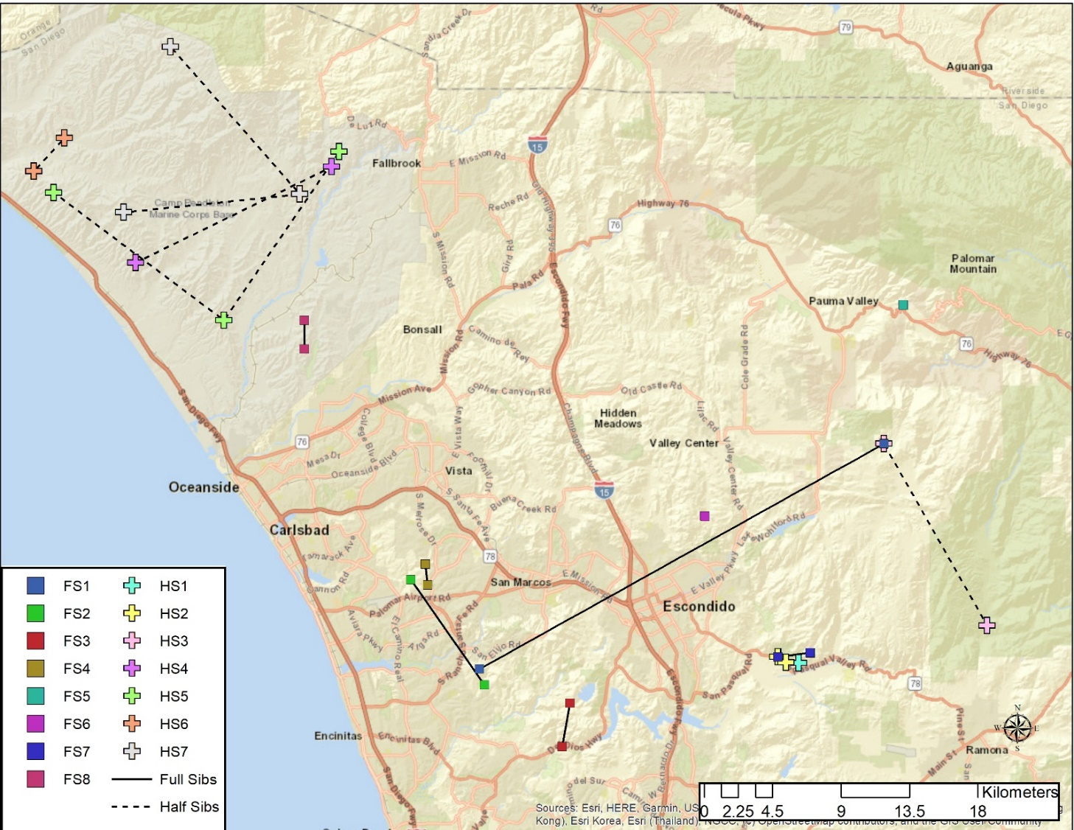
Pedigree Analyses
Notes:
So, what if we are not able to recapture the same individual? We can also use the genetic data to do a pedigree analysis and identify close relatives in our data set, which is an indirect way to measure movement on the landscape. On this map, we see the results of pedigree analyses from the North County data. Here full siblings are identified with solid squares and half siblings with pluses. Each pair or group of siblings are then joined with solid or dotted lines, depending if they are full or half siblings. So in Camp Pendleton we found 4 groups of half siblings, and one pair of siblings.

Slide 19
Population Structure
Notes:
We can also use the same genetic data set to look at longer term patterns. We can throw all the individuals into a genetic clustering programs and ask if there is any population structure. In fact, when we analyze our data, we find there are 2 genetic clusters here. This is the output from one clustering program, called STRUCTURE> Here each deer is represented by a vertical bar on the plot and the 2 colors represent the 2 genetic clusters that the program detected based on the data. We can see what proportion of each individual’s genetics comes from the 2 different clusters. You can see also that some individuals belong mostly to the blue clusters, some to the orange and some are admixed.
If we plot this info on a map, the pattern is easier to see. Here, each site is represented by circle, with circle size being dependent on number of individuals identified at the site. On this map, each circle represents the proportion of the site’s genetic background coming from each of 2 genetic clusters (blue and orange).
So we see two genetic clusters for deer in the North County region, the Coastal and Inland/Mountain, with gene flow occurring within and between these. You can see that most of the individuals in CP and NE North County derive most of their genetic information from the blue genetic cluster. In contrast, many of the individuals in Carlsbad and West Escondido derive much of their genetic information from the orange genetic cluster.

Slide 20
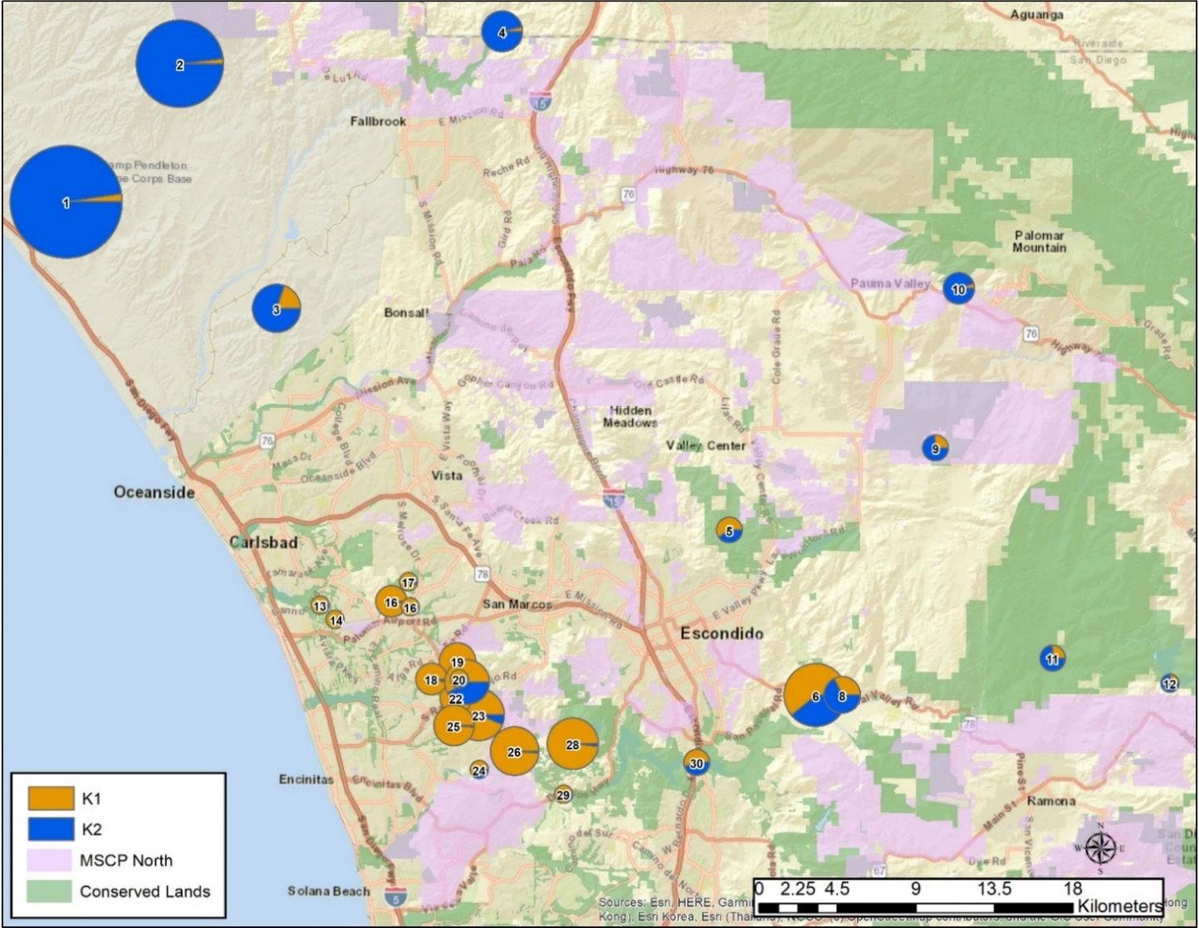
Population Structure
Notes:
If we plot this info on a map, the pattern is easier to see. Here, each site is represented by circle, with circle size being dependent on number of individuals identified at the site. On this map, each circle represents the proportion of the site’s genetic background coming from each of 2 genetic clusters (blue and orange).
So we see two genetic clusters for deer in the North County region, the Coastal and Inland/Mountain, with gene flow occurring within and between these. You can see that most of the individuals in CP and NE North County derive most of their genetic information from the blue genetic cluster. In contrast, many of the individuals in Carlsbad and West Escondido derive much of their genetic information from the orange genetic cluster.

Slide 21
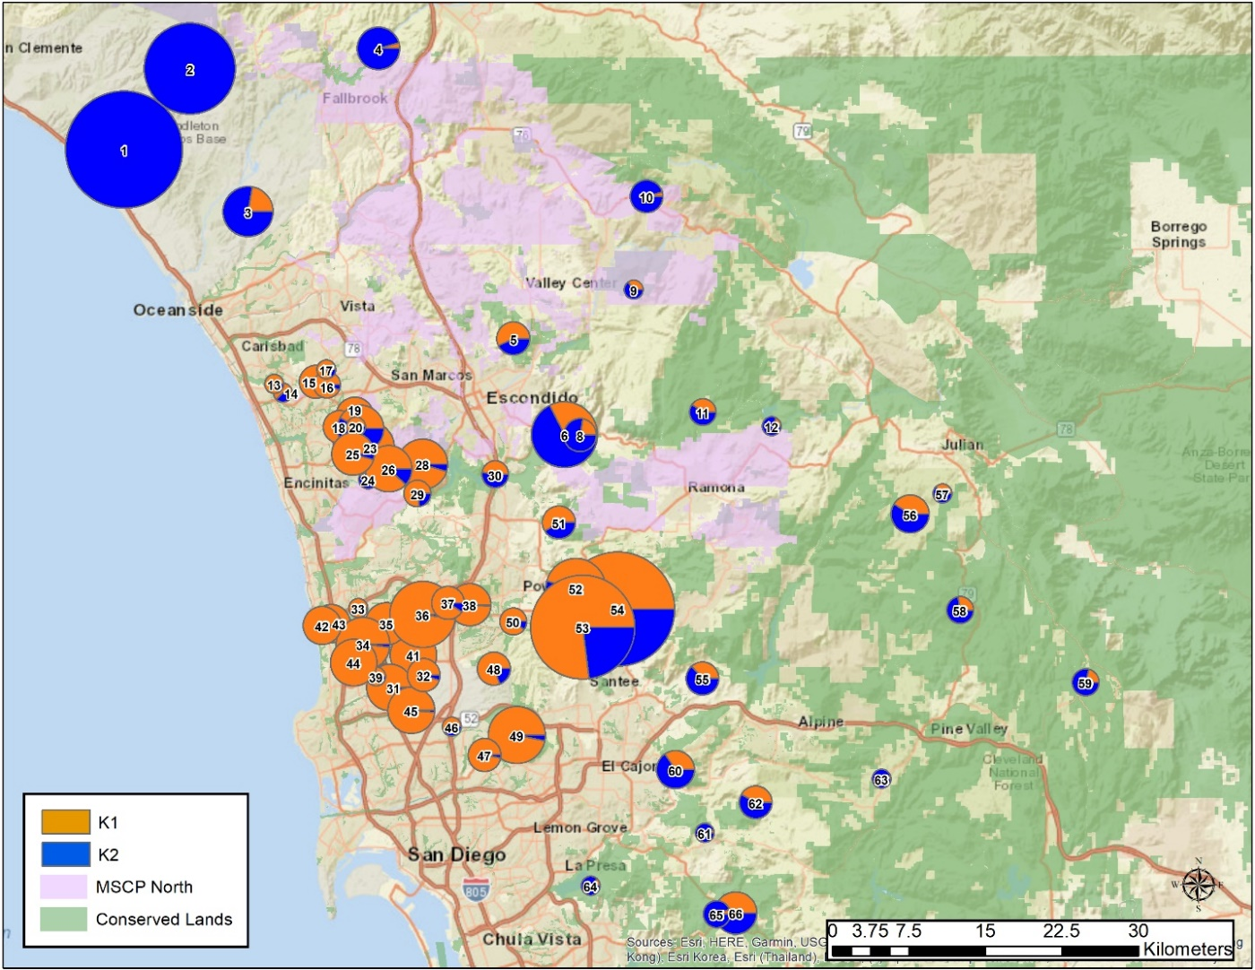
Regional Population Structure
Notes:
Similar results on the regional level. Note that MCBCP deer are “genetically closer” to SE San Diego county deer than deer in Carlsbad, even though CP and Carlsbad are closer together geographically.

Slide 22
Regional Population Structure

Slide 23
Effective Population Size
Genetic Cluster | Putative Geographic Population | Sample Size | Alleles | N_{e} (min, max)
Inland/Mountain (north of I-76, East of I-15) |  | 213 | 4.3 | 100.2 (81.5, 125.3)
 | NW-NoC | 73 | 4.6 | 178.2 (93.2 , 796)
 | NE-NoC | 30 | 4.4 | 17.8 (12.6 , 26.4)
 | BC-SC | 45 | 3.9 | 77.3 (39.5 , 333.4)
 | East | 48 | 4.4 | 53.9 (35 , 98.2)
 | SE | 17 | 4.1 | 39.3 (16 , Infinite)
Coastal (Coastal, south of I-78; West of I-15) |  | 146 | 3.5 | 64.8 (51.1, 83.9)
 | SW-NoC | 59 | 4.0 | 45.1 (31.7 , 69.4)
 | West | 14 | 3.1 | 17.5 (7.2 , 127.5)
 | MT-TR-MirDEG | 22 | 3.9 | 21 (11.9 , 47.9)
 | MirNW | 9 | 3.2 | 11.9 (3.1 , 21917.2)
 | Pq-PC | 34 | 3.9 | 180.1 (54.6 , Infinite)
 | CC-MirEM | 8 | 2.8 | 19.3 (3 , Infinite)
Notes:
One additional analysis I’d like to highlight here is that of Ne. This number is the number of individuals that are successfully breeding in the population, so it will always be smaller than census population size. However, this number is important for predicting long term population persistence. Recent work has shown that populations with less than 100 individuals have a high probability of extinction.

Slide 24
Thank you – Phases I-III
Tracking Team Members: Barry Martin, Uli Burgin, Carol Crafts, Anna Gateley-Stanton, Bill Grabb, Sarah Haas, Denise Harter, Juliet Hendershott, John Kiss, Fred Kramer, Karen Larsen-Gordon, Mac MacNair, Karen Merrill, Lani Noreke, Don Rowe, Frank Santana, Doug Schanzenbach, Gary Seiser, Shankar Shivappa, Phoenix Von Hendy, Bryan Webber, Bryan and Diane Woodson, Jerry Woodworth.
Grad students and land managers: Steven Thomas , Stephen Rice, Paul Maier, Rachel Snoops, Megan Jennings, Chuck Black (MCAS Miramar), Bill Bretz, John Martin (FWS), Tracie Nelson (DFG).
Land owners and managers: San Diego County Department of Parks and Recreation, CDFW, SD Watershed and Resource Protection, City of Poway.
Lab work – Kathleen McNamara Schroeder, Gi Hye Im, Paymaun Shakiba, Jacques Calame, Justin McKetney, Stefania Veneri
Funding – CDFW, SANDAG, SDMMP, USGS
Notes:
I would like to acknowledge so many people who have contributed over the years to this project, all of whom volunteered their time so generously to collect samples. I would especially like to thank the San Diego Tracking Team. Land owners and managers who granted site access for field collection and often guided and assisted with collections. I have had help from many undergraduates with keeping up with the DNA extractions. Funding over the years has come from SANDAG, CDFW, SDMMP

Slide 25
Thank you – Phase IV
We would like the thank the following people and the many volunteers who assisted them for their help with sample collection and/or property access —Markus Spiegelberg, Jake Garcia, Sarah Godfrey, Brooke Prentice-Dekker, Stephen Rink (Center for Natural Lands Management); Michael Tucker (Camp Pendleton); Charlie de la Rosa and Emily Burson (San Diego Zoo Safari Park); Leana Bulay and Jason Lopez (San Dieguito River Park); John Barone (City of San Diego); Hans Sin (California Department of Fish and Wildlife); Karla Standridge (Fallbrook Land Conservancy); James Bourdon and Pablo Bryant (Santa Margarita Ecological Reserve); Zach Principe and Trish Smith (The Nature Conservancy); Winston Vickers (University of California South Coast Research and Extension Station); Kurt Broz (Pala Environmental Department); Hannah Walchak and Ann Van Leer (Escondido Creek Conservancy); Margaret Diss, Ashley Dulaney and Nick Sloan (San Diego County Department of Parks and Recreation); Sarah Krejca and Austin Parker (San Diego Habitat Conservancy); Laurie Carter (Friends of Hellhole Canyon); Evelyn and Mickey Vineberg, Diane and Bryan Wold (San Diego Tracking Team); Kim Wehinger (City of San Diego Public Utilities Department); Dan Hippert (City of Escondido, Lakes and Open Space); Jeff Anderson (Elfin Forest Recreational Reserve). We are grateful to Megan Jennings, Kristine Preston and Carlton Rochester for their insight and advice on collection locations.
Notes:
Thank you for 2018-2019 collections!

Slide 26
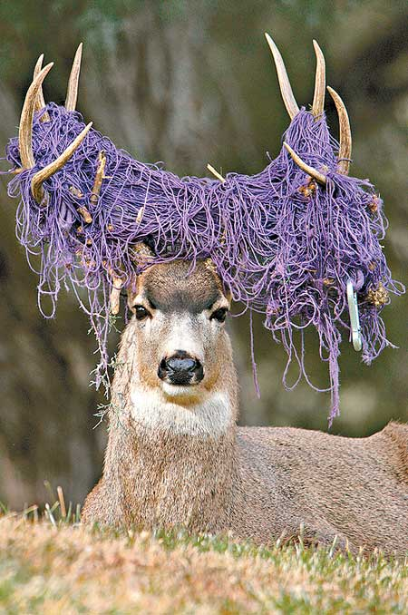
Questions?
Notes:
amitelberg@usgs.gov
avandergast@usgs.gov

