Slide 1
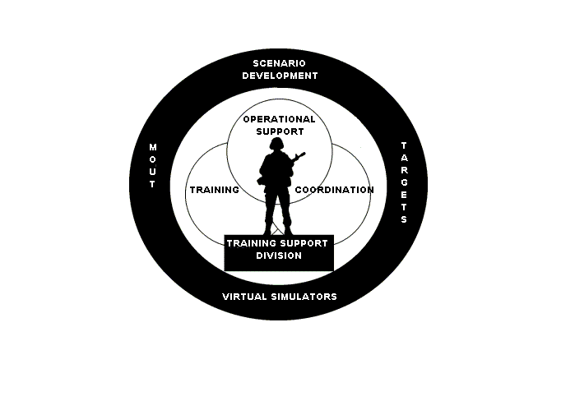
Training Support Division
Building 2238
Phone: 760-725-6139
mcb_campen_tsd_trg_dev@nmci.usmc.mil

Slide 2
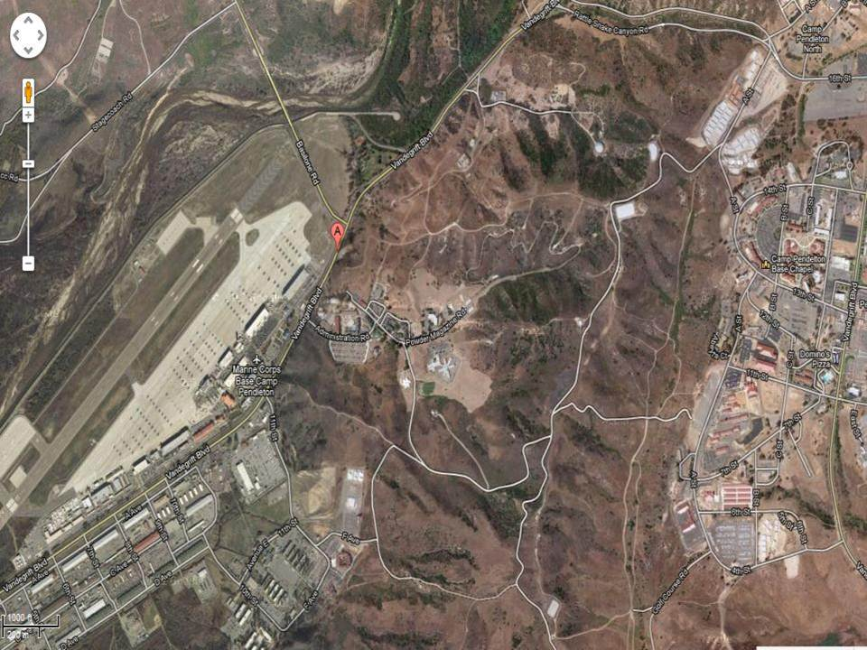
Warehouse Location
BLDG 2238

Slide 3
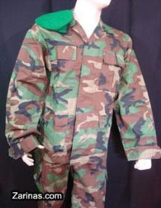
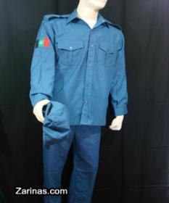
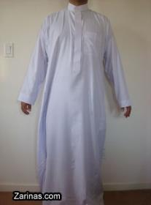


Afghanistan Clothing
Pakol
Army
Police
DishaDasha
DishaDasha Tops | 99
DishaDasha Bottoms | 45
Shimagh | 79
Pakols | 27
Police Tops | 38
Police Bottoms | 38
Police Hats | 44
Afghan Army Tops | 27
Afghan Army Bottoms | 27
Afghan Army Barret | 49
Shimagh

Slide 4



Afghanistan Clothing
Egal
Burqa
Hijab
Burqas | 8
Hijab | 8
Egal | 40

Slide 5
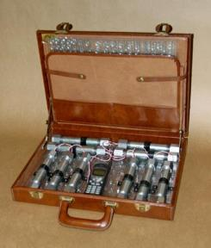
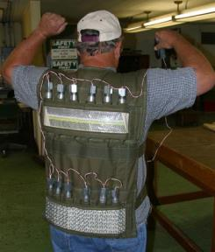
IED/Mines/Ammunition
Brief Case Bomb
Suicide vest
Suicide Vest | 21
Briefcase Bombs | 8

Slide 6
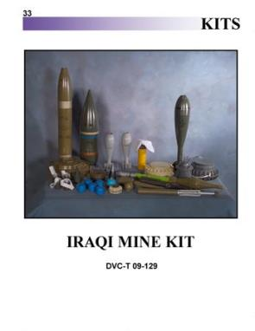

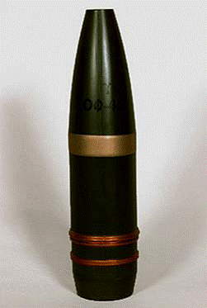


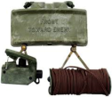
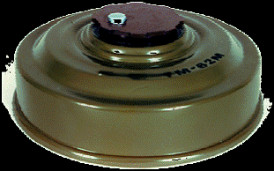
IED/Mines/Ammunition
Mines | 102
Projectiles | 188
Claymore | 34
Projectiles
Mortars
Mines and Claymores

Slide 7
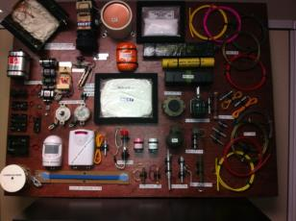
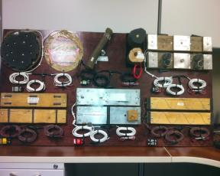
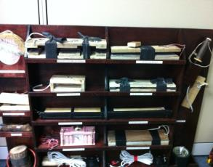
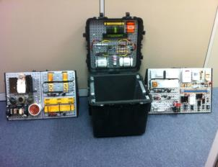
IED/Mines/Ammunition
IED’s available at the MTD warehouse Bldg 2238 using current enemy TTPs. High, medium, and low metallic, command wire, pressure plate, and radio controlled devices.

Slide 8
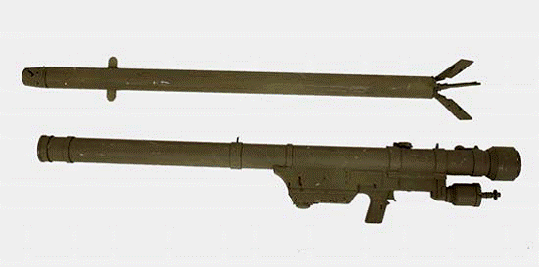
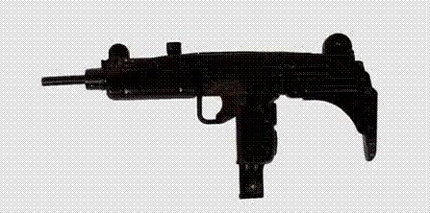


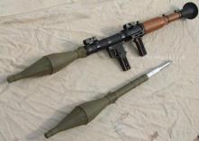

Weapons
Mini Uzi
SA-7 Grail
Uzi
Ak 47
RPG
RPK
SA7 | 22
RPG | 38
Mini Uzi | 13
Uzi | 16
RPK | 21
AK-47 | 69

Slide 9

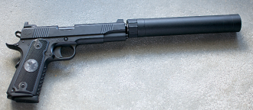
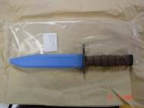
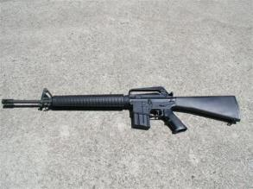
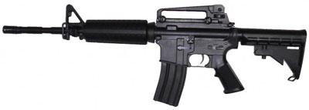
Weapons
9mm
Pistol w/silencer
KBar
M4
M16
M16 | 165
M4 Carbines | 44
9MM | 16
K-bars | 100
Silencer Pistol | 13
Small Pistol | 28

Slide 10
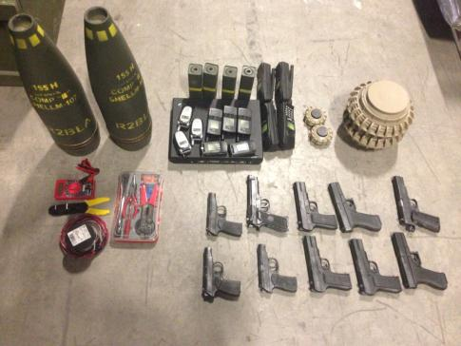
IED Kit
** 3-5 of each kit is available

Slide 11
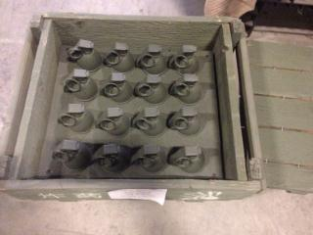
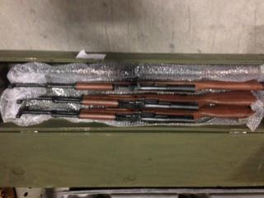
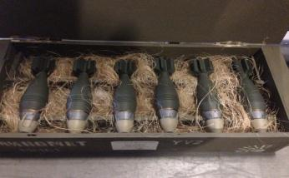
Weapons Cache
** 3-5 of each kit is available

Slide 12
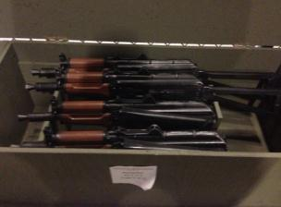
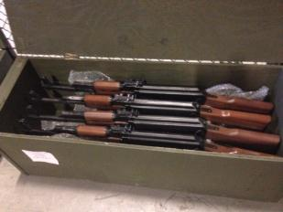
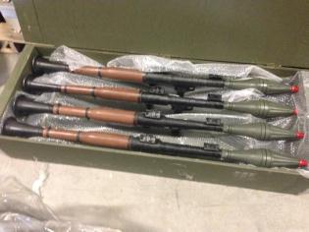
Weapons Cache
** 3-5 of each kit is available

Slide 13
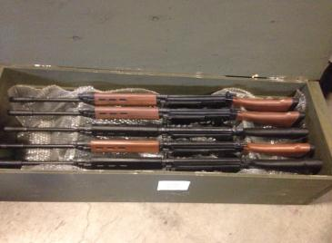
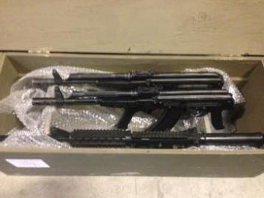
Weapons Cache
** 3-5 of each kit is available

Slide 14
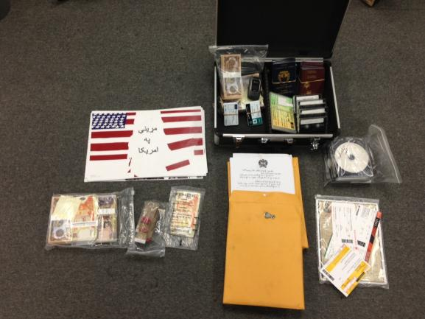
Travel Kit
** 3-5 of each kit is available

Slide 15
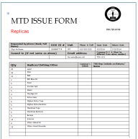
I want to order
M16
M4
AK47
RPG
MINES
AK47
SUCIDE VESTS
AFGHAN CLOTHING
Etc..
1. Go to: http://www.pendleton.marines.mil/StaffAgencies/AssistantChiefofStaffG35/TrainingSupportDivision/TrainingDevices.aspx
2. Fill out the replica/clothing form and email it to: mcb_campen_tsd_trg_dev@nmci.usmc.mil
3. An approval email will be sent within 24 hours.
Or:
You can do a walk in at building 2238 Rm 126 and get the equipment if available.
You can call us at 760-725-6139 and do a reservation over the phone. Call 760-725-4444 if no one is available at the primary number.

Slide 16
Target Systems
Provided by ESP Contractors
725-4805/760-385-5120
http://gtssw-espinc1.com

Slide 17
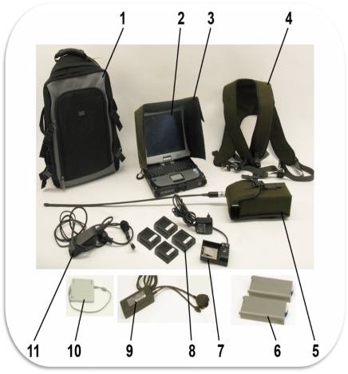
SAAB PIT AND HAND HELD CONTROLLER
The GRC5 program offers full drag-and-drop support for range and scenario design. Items such as targets, pyrotechnics, movers and maps can easily be added to the range configuration. The range is graphically presented on screen and targets are shown with current status in real time. GRC5 is a user-friendly tool to assist the instructor in planning an exercise.
There are no program limitations to the number of targets, tasks or commands that a range or a scenario can handle. To run a pre-programmed scenario the operator use simple play/pause/stop buttons. Training data is collected and stored during the execution of an exercise. Applicable score sheets (individual, firing order, etc.) can be produced and printed.
The GRC5 program contains the following tabs: Scenario Player, Scenario Designer, Range Maker and AAR Playback:
•Scenario Player is used for running pre-programmed scenarios or to manually control the target equipment. The scenario player view also has the tools for viewing or printing results.
•Scenario Designer is used for creating or editing scenarios, here by assisting the operator in handling complex or repeated command structures.
•Range Maker is used for creating or editing a range. With simple Windows type tools, targets are placed on a chosen background. In Range Maker, targets can easily be joined into blocks for simultaneous actions.
•AAR Playback is used to review results from a previously recorded scenario. The playback reflects all events that occurred during the scenario in real time. Not Applicable for HHC.
Laptop Computer
Backpack
Sun Cover
Computer Harness
Main Power Adapter
Computer
Wireless Base Unit (WBU)
Battery Charger WBU
Battery Computer
DVD/CD drive
Battery Charger
Battery WBU

Slide 18
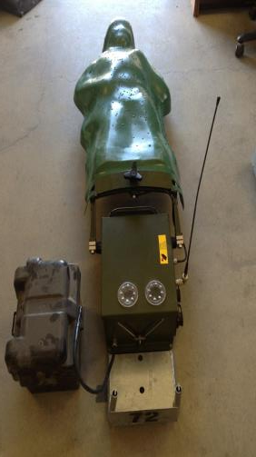
SAAB PIT
Hit Sensing: Single Shot and Burst Count Modes
Hit Detection: Target Commands Expose, Conceal, Hit-Hold, Hit-Fall, Hit-Bob, Hit-Stop
Grouping: Timed groups scenarios.
Accessories: Can be tested by push of a button. It has a light which will provide muzzle flash simulation or illuminate the target during night shoots.
**Scenarios can be saved. Can also be saved to thumb drive or on laptop in a folder.
Weight: 46lbs w/out battery (A fully charged battery will last up to 10 hours of continue use.)
Battery: 27lbs
Stackable up to 3 high. Requires a battery, an ivan, an antenna, a shield and 16-18 sandbags and laptop control.
How many fit in a :
HMMWV = 15 (with no seats) Trailer or another vehicle is needed for the other required items, not counting sandbags.
7 Ton = 15 with all required items included in the same vehicle

Slide 19
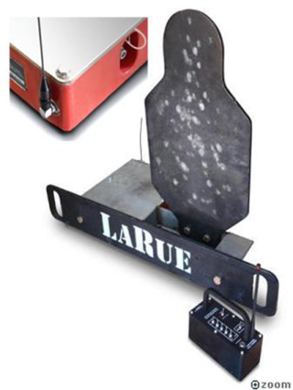
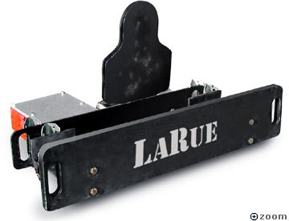
LARUE TACTICAL
BATTERY POWERED. Automatically resets 1800 times between charges.
Timed to reset in 9 seconds, then shuts off, saving power and leaving
it ready. Battery is internal and weather proof.
MAN PORTABLE. 72 lbs. total weight. Totally self-contained, no assembly
Required. No set-up, no hoses, no wires! Requires 3 sandbags over the battery/control box.
BATTLE TOUGH. 3/8” thick 500 Brinell target. Withstands .223s and .308s. 1" thick version for .50 cal ball with own shield.
REMOTE READY. Larue 5.56 are remote capable. Up to 5 sets of targets can be controlled by operator manually.
Weight: 72lbs
Stackable during transportation.
  HMMV= 20-25 (removed seats)
  7 Ton = up to ~40

Slide 20
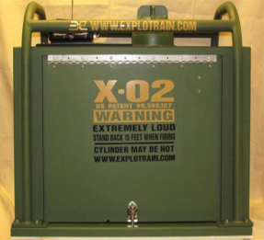

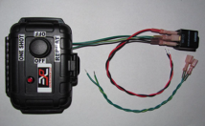
X-02 SIMULATOR
The X-02 uses a 12 volt rechargeable battery for its DC power supply. One battery will last up to 6 hours of continuous use.
The X-02 is a self contained unit where the oxygen and propane are internal tanks. It uses a blended mixture of oxygen and propane ignited in an open chamber to achieve the sound level and simulated blast effects to replicate a variety of threats such as IEDs at 100dB-130dB
Capable of firing off up to 150 shots per full tanks in increments of one shot per 5-6 seconds.
Weight: 40lbs
Two Man Carry
TCU-Trigger Control Unit can be connected to a variety of triggering devices. For example: vehicle pressure unit, trip wire and motion sensor

Slide 21
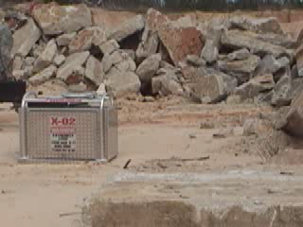
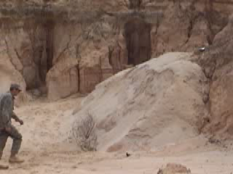
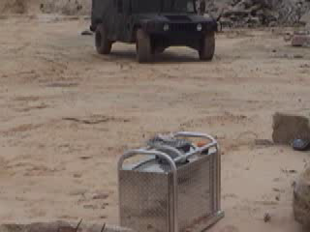
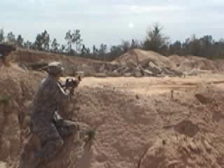
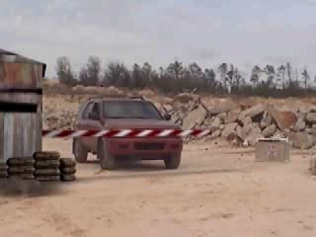
XO2- Scenarios and Command Detonations
EOD Training Scenario
Booby Trap Scenario
Roadside IED Scenario
Provides the most realistic and objective training scenarios
Detonation and arming on command provides instructors complete control
Instructors may also remotely detonate and disarm even when using automatic triggers and sensors
Artillery Simulation Scenario
Security Checkpoint Scenario

Slide 22
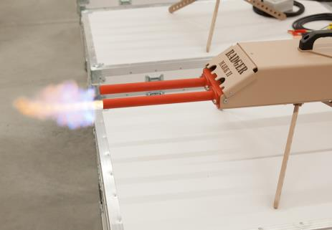
BADGER AK-47 SIMULATOR
The Badger is a remotely operated simulation of an AK 47 assault rifle. It uses combustion of oxygen and propane mixture. To simulate the flash, noise, and percussive effects of the AK-47.
Capable of firing either single shots or 6 round bursts at a 600 rounds per minute cyclic rate of fire.
Badger Weight: 36 lbs
Large Oxygen Tank: 146 lbs
Large Propane: 35lbs
  (Full tanks together will last up to 10 hours of continue use. Approximately 2000+ rounds)
Battery: 27lb
  (A fully charged battery will last up to 10 hours of continue use.)
  ** Containers should be strapped down to prevent rolling.

Slide 23
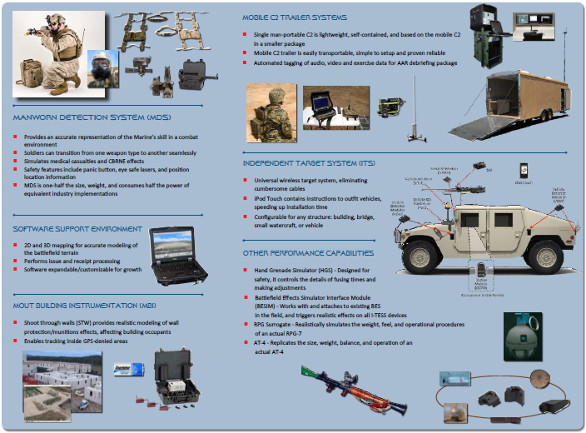
Range Training and Instrumentation Systems Support (RTISS)
Bldg 2238, Hatch 19

Slide 24
I want to order
Badger Simulators
XO 2 Simulators
Portable Infantry Targets
LaRues
SESAMS
T-IED Simulators
ITESS Equipment
Training
Go to:
http://gtssw-espinc1.com
Or call:
760-385-5120 / 760-725-4805

Slide 25
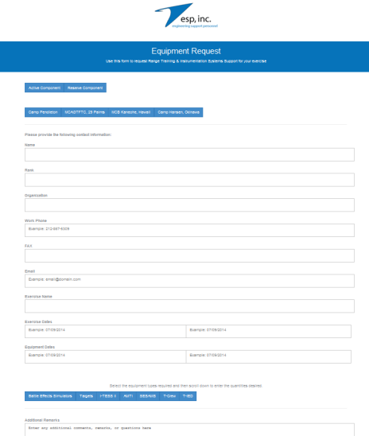
Process
ESP Website Step by Step
Click Active/Reserve
Choose Location
Fill in information
Click type of systems wanted
  More requested space will show
  Fill in requirements
Any other information place in the comments box: for example training needed, specific extra equipment not listed.
Click submit
A pop up will appear stating a successful transaction.
Within 24 hours a tech will call you.
Note there is a directory on the site incase of changes or if more information is needed.

Slide 26
ESP Requirements:
1. There is a 24 hour business day period needed to evaluate your request in order to see the availability and perform the equipment preparation process.
2. Individual requesting needs to be qualified in equipment operations and be listed as a qualified person who will pick up and operate the equipment during the training evolution (All Personnel can go through training and hold a Minor Training Device [MTD] card for equipment operations of all equipment except SAAB PITS**). The MTD card will expire one year from training.
3. Training courses to obtain an MTD card are scheduled as follows: Badger, X-02, and LaRue Targetry classes are held every Tuesday at 9:00. SAAB PIT (general knowledge course) are held every Wednesday at 9:00.
4 . Individual who is picking up equipment needs to be an E-5/SGT* or above and hold an MTD card. (E-1 thru E-4 may place requests only and provide a qualified name in the comment’s section for equipment pick-up).
5. If a civilian contractor or non-military end user is picking up he/she needs to be sponsored by a unit authorizing him/her to pick up the gear. That unit POC needs to place the request. (Civilian operator needs to be on the qualified MTD roster)
6. When returning the equipment, the same individual who signed-out equipment needs to return the equipment.
7. During return, if there is any missing or damaged equipment a DD 200 form will be filled out in order to begin the command investigation process.
8. Working party and correct Government size vehicle for transportation is needed for pick up and drop off. For reservation questions call ESP at 760-725-4805. For any maintenance issues contact the ESP contractor numbers on your form between the hours of (07:00-16:30) 760-725-4805 (For BES/Targets) or 760-385-5120 (For ITESS, AMTI, SESAMS, T-CREW, T-IED).
Special Notes:
*Requestor and/or Operator name must be listed and hold an MTD card in order to pick up and operate the equipment. If the name of the operator or person picking-up equipment is not on the qualified roster, the request will be denied. If you believe your request is going to be denied please call 760-725-4805 or list on request remarks that training is needed for equipment being checked out in order to add training dates and times to your request.
**Beginning 20 January 2015, PIT operator and emplacement support will be provided by Training Support Division. Prior coordination between the requesting unit and TSD must be accomplished in order to ensure support is provided on the required dates/times. Feel free to contact 760-725-4444 for assistance with obtaining the PIT operator support.

