Slide 1



Marine Corps Base
Camp Pendleton
Resident Energy Conservation Program (RECP) Brief
for
Hunt Military
Housing Residents

Slide 2
Purpose
Provide Housing Residents with information on the Resident Energy Conservation Program (RECP) and timeline for implementation aboard Marine Corps Base Camp Pendleton.
Notes:
2

Slide 3
Background
Office of the Secretary of Defense Memorandum of 8 September 1998 set policy for the payment of utilities in Public Private Venture (PPV) family housing.
  Allows payment by resident for excess utilities utilization
  PPV operating agreement includes this provision
  Army started in 2003; Air Force in 2006

Slide 4

Background
HQMC approved implementation of the Resident Energy Conservation Program (RECP) at all PPV Projects - January 2012
  RECP goals are consistent with DoD, DoN and USMC conservation principles
  RECP Pilot Program has been running since Sep 2010
    Conducted at MCB Hawaii, MCRD Parris Island, and MCAS Beaufort from Sep 2010 to date
    Navy conducted parallel pilot program in Hawaii
    RECP Concept was Proven Successful
    Electric Use & Costs dropped about 9%
  Concept was proven and refined

Slide 5
Resident Energy Conservation
Program (RECP)
RECP reduces electric costs, and saves funds for sustainment and improvements.
  Cost savings generated by RECP will be used to improve homes, playgrounds, community centers, and quality of life
  Helps protect our $2B investment in new housing and communities
  Basic Allowance for Housing (BAH) is only expected to cover “normal” utilities use/costs, not excess.
  Military Housing has traditionally used excess utilities
  Most Families live off base and pay full utilities
  12% of Camp Pendleton BAH is allocated for utility usage (electric, gas, water, sewer, and trash)
Notes:
5

Slide 6
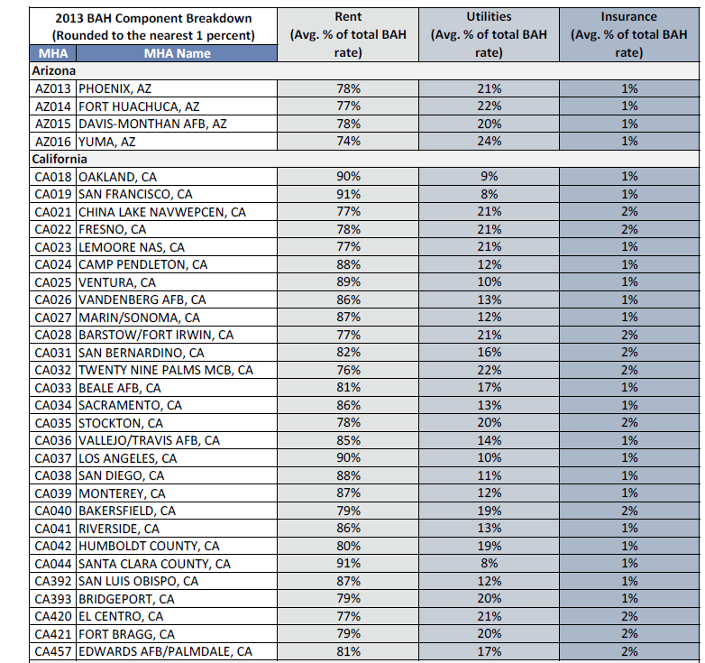
Resident Energy Conservation
Program (RECP)
Notes:
6

Slide 7

Resident Energy Conservation
Program (RECP)
RECP will encourage energy conservation
  Residents using less energy will be rewarded with cash / credit
  Residents using more energy will be billed for only the excess
  Each Family can influence their own destiny
Notes:
7

Slide 8
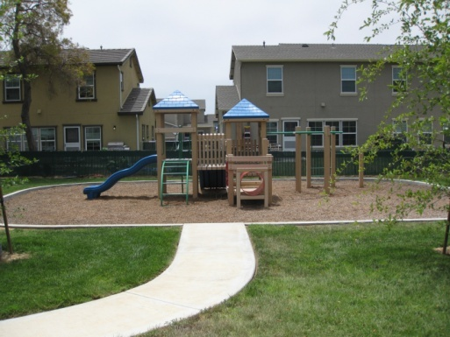
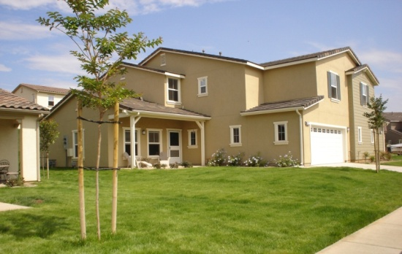
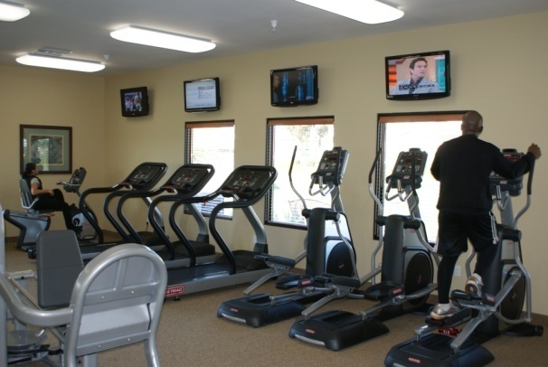

  “Cost Savings = Improvements”
Notes:
8

Slide 9
RECP Program
Concept of Operations
Establish Housing Types
  Based on location, size, style, age, and number of bedrooms
  Electric Metering
  Hunt Properties (Deluz) are 100% metered
  Lincoln Properties are 100% metered
  Calculate Average Usage for each Type each Month
  Top/bottom 5% not considered in average
  Establish Average Range
  Residents within +/- 10% of average have no cost impact
  Residents outside range will get a refund or be billed for only excess not total
Notes:
9

Slide 10
RECP Program
Concept of Operations
  Notional / Example Monthly Electric Usage
x
Example Individual
Resident Impacts
x
x
x
x
x
x
x
x
x
x
Bill for use over 110 kWh
Consumption (kWh)
x
x
x
x
x
x
x
No Credit and No Bill from
90 kWh to 110 kWh
x
x
x
x
x
x
x
x
Credit for use under 90 kWh
10 of 12
Fall Month
Notes:
10

Slide 11
RECP Program
Concept of Operations
  Notional / Example Monthly Electric Usage
x
x
x
x
Example Individual
Resident Impacts
x
x
x
x
x
x
Bill for use over 121 kWh
x
x
Consumption (kWh)
Consumption (kWh)
x
x
No Credit and No Bill from
99 kWh to 121 kWh
x
x
x
x
Credit for use under 99 kWh
11 of 12
Winter Month
Notes:
11

Slide 12
RECP Program
Concept of Operations
  Exemptions:
  For some Wounded Warriors and Exceptional Family Members
  Not part of program
RECP will be implemented in two phases starting Calendar Year 2013
  Phase I Housing Areas:
    Deluz, Del Mar, San Mateo Point, San Onofre I/II/III, South Mesa I, Stuart Mesa II, Wire Mountain I/II and San Luis Rey
  Phase II Housing Areas:
    Del Mar (Koepler St), Forster Hills, O’Neill Heights, Pacific View, Santa Margarita, Serra Mesa, South Mesa II, Stuart Mesa, Wire Mountain III, and 14th Street
Notes:
12

Slide 13
RECP Program
Concept of Operations
  Timelines are projected and subject to change
  Before live billing begins:
  Establish like-type housing groups
    May - June 2012
  RECP Leadership briefs
    July - October 2012
  CG MCIWEST-MCB CPEN Notification Letters and Program Information to Residents
    September 2012
  Publish Articles in Base Papers / Newsletters / Website
    http://www.pendleton.marines.mil/Family/FamilyHousing/ResidentEnergyConservationProgram.aspx
    October 2012
    Updated July 2013
Notes:
13

Slide 14
RECP Program
Concept of Operations
PPV Partner Send Notification Letters to Residents
  Phase I: October 2012
  Phase II: July 2013
Town Hall Meetings / Energy Forums
  Phase I: October 2012 - December 2012
  Phase II: July 2013 – May 2014
Execute Lease Modifications
  Phase I: September - December 2012
  Phase II: January - December 2013
Notes:
14

Slide 15
RECP Program
Concept of Operations
PPV Partner sends 3-Month Mock Billing Notification Letters
  Phase I: December 2012
  Phase II: November 2013
PPV Partner sends Live Billing Notification Letters
  Phase I: March 2013
  Phase II: February 2013
Start Live Billing
  Phase I: 1 April 2013
  Phase II: 1 March 2013
Notes:
15

Slide 16
RECP Program
Concept of Operations
    Government, PPV Partners and Third Party Vender monitor program
  December 2012 - December 2014
    RECP Expectations:
  Electricity use will drop 12-15%, saving $2M per year
  Savings will be used for family housing improvements
  Most families will NOT be billed for utilities
Notes:
16

Slide 17
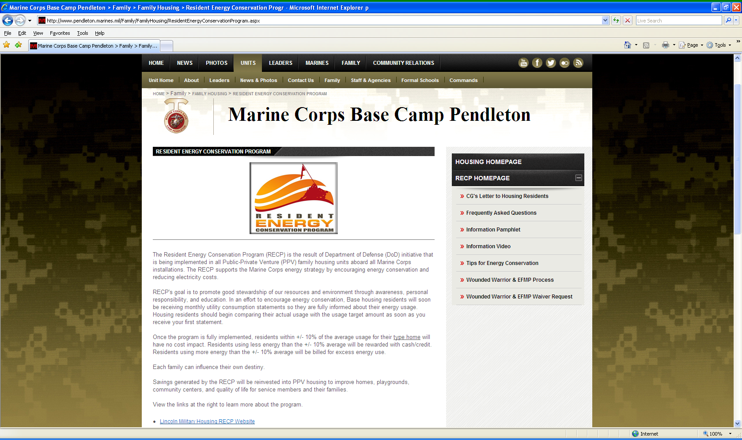

Slide 18






Resident Energy Conservation Program
Resident Briefing

Slide 19

Agenda
Introduction
Program Overview
  Profiles
  Baseline Calculation
  Utility Billing Process
Conservation
Questions & Answers

Slide 20

Corporate Overview
Founded in 1952, Minol is the third largest Billing, Energy Management, Sub-Metering and Product Solution providers with 2,500 employees and 32 offices worldwide.
Leading provider of utility metering and billing services for electric, gas and water for residential and commercial properties, as well as military housing communities.
Worldwide utility meter distributor
and manufacturer
Our global team produces more than 5.4 million bills annually.

Slide 21

Purpose of Program
OSD policy dated September 8, 1998 mandates payment of utilities in privatized housing and strive to achieve energy efficiency in homes.
Conservation decrease the national dependence of foreign oil and conforms to our national policies.
Savings in energy costs will go to residents by providing improved housing and ancillary facilities.

Slide 22
How Does It Work?
The Resident Energy Conservation Program (RECP) is designed to set reasonable utility allowance targets for normal utility consumption in privatized housing.
A “mock billing” period will occur in which information will be provided to residents, showing consumption compared to the average for the home.
  During “mock billing”, residents are not responsible for overages or qualify for rebates.
After “mock billing” ends, residents will receive Live invoices and will be responsible to pay for usages above the average allowance. If the usage is less than the allowance, residents will begin accruing credit for refunds.
A rebate check will be issued once accrual meets or exceeds $25. However, residents may choose to accrue the rebate and apply any credit amount for future payments.

Slide 23





Billing Process
Monthly Billing Cycle
Meter Reads
Resident Activity
Utility Rate
Pre-bill to Manager
Approval by Manager
Mail to Resident
Resident Services & Tools

Slide 24

Baseline Average
To determine the baseline calculation:
  Remove zero usage
  Remove unoccupied homes
  Remove partial billing periods (move in & move out)
  Calculate current average consumption
The average is considered the baseline per profile
The baseline is a rolling average, changing each month.
Notes:
24

Slide 25

Overview
Minol will mail a monthly statement reflecting resident energy usage.
Statement will reflect applied utility average.
The statement will show the difference between the average (baseline) and the resident consumption.
Use less than baseline = CREDIT
Use more than baseline = CHARGE
Action Trigger = $25.00
If Credit or Charge is within $25
= NO ACTION (bill or rebate accrues)
Notes:
25

Slide 26

Statements
Resident will receive one of three statements:
  Payable Due Statement (Payment Coupon)
    Utility Charge is greater than Baseline
    and greater than $25 trigger
  Rebate Statement (Check Issued)
    Utility Charge is less than Baseline
    and greater than $25 trigger
  No Action Statement
    Difference between the Utility charge and Utility allowance is within the $25 Trigger

Slide 27
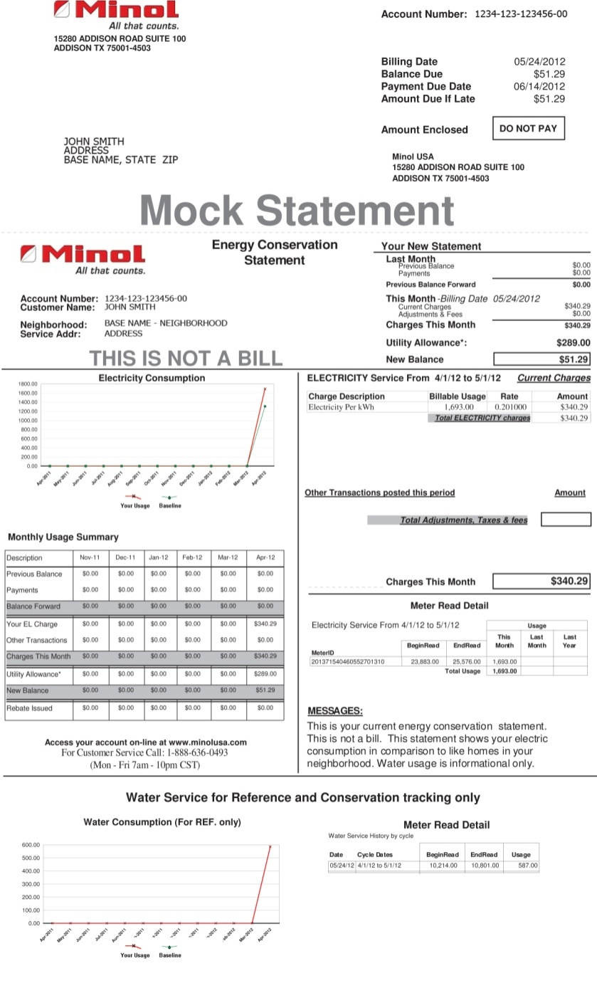
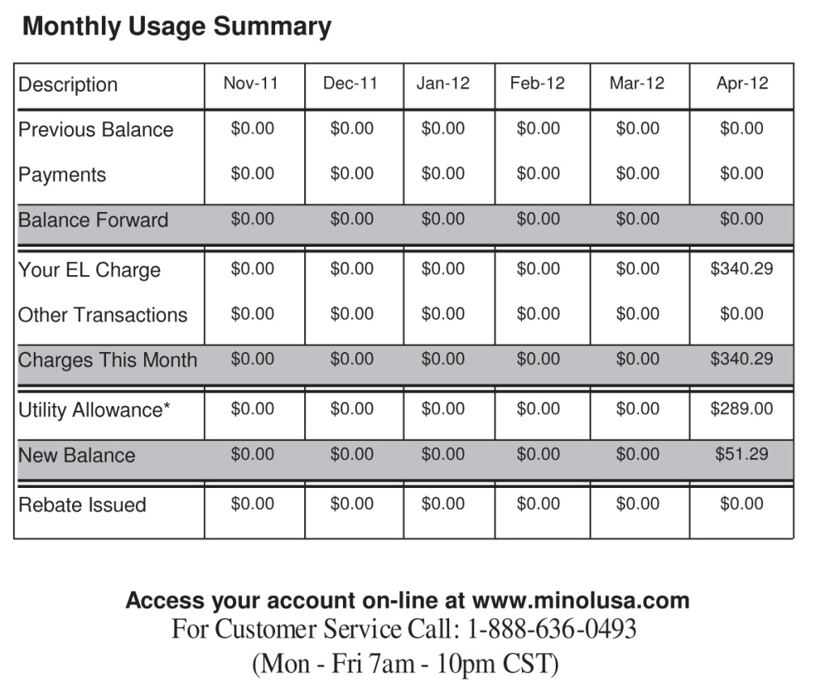
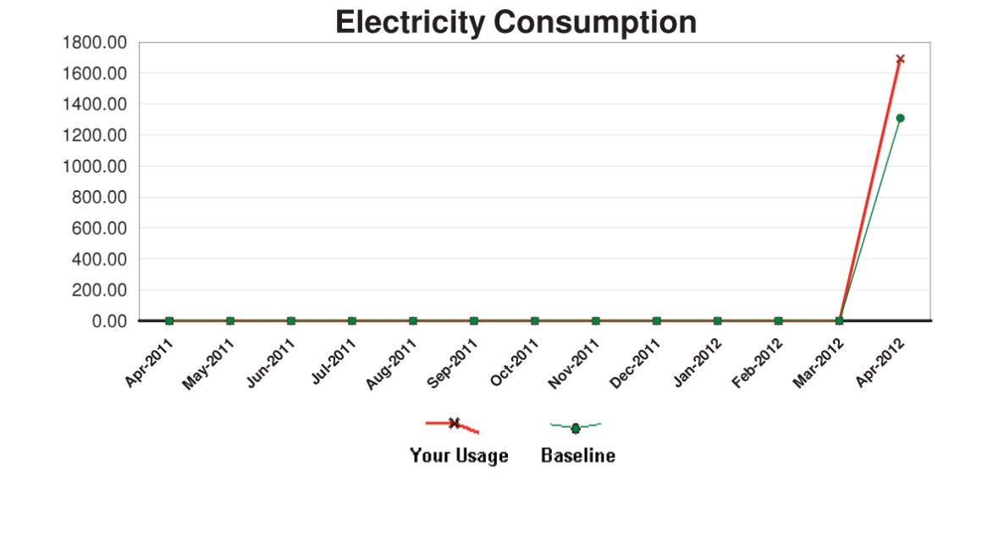
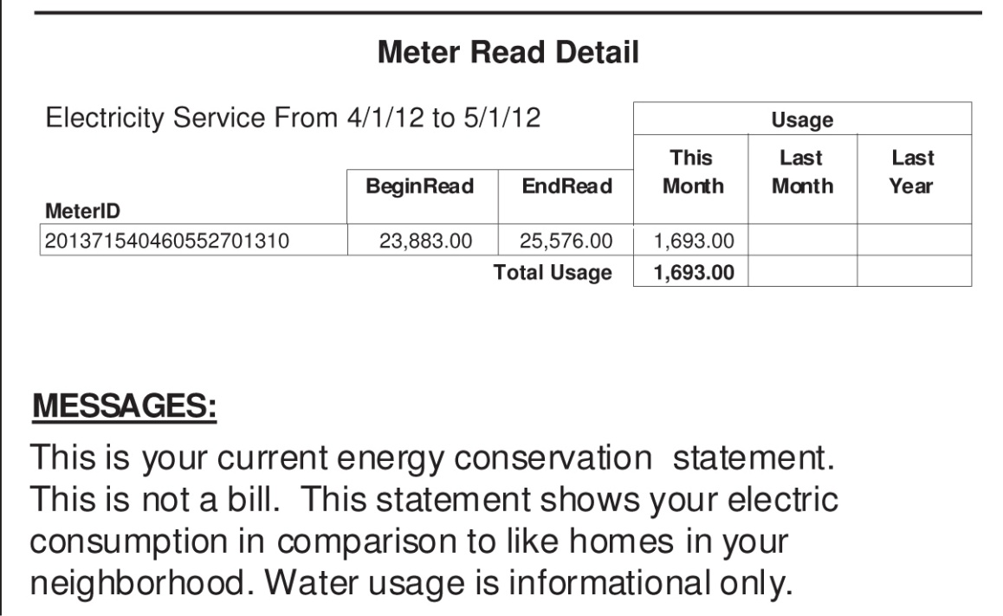
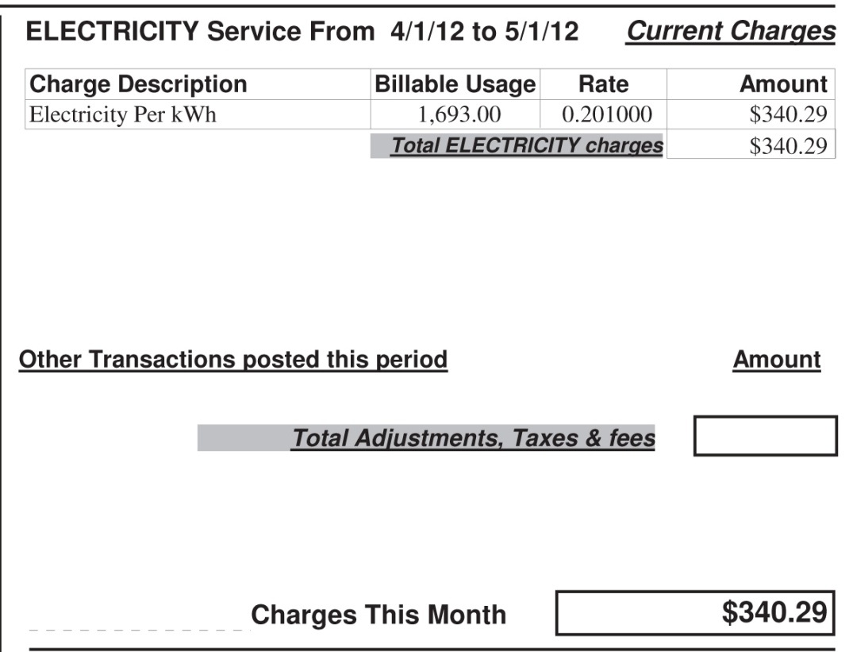
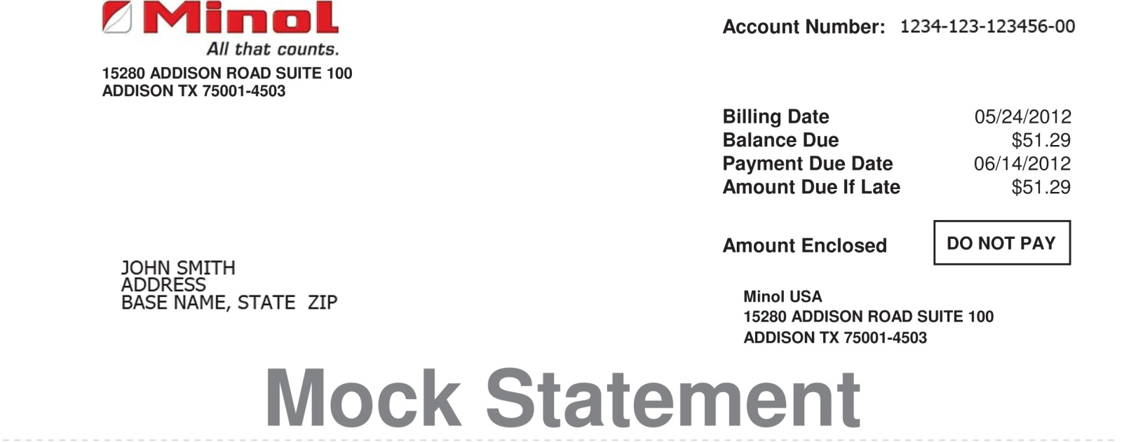
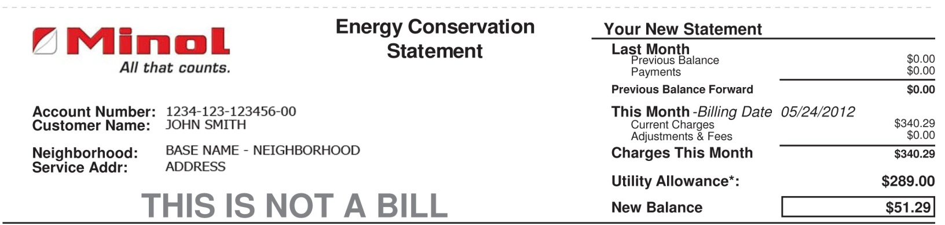
Payable Action Statement

Slide 28
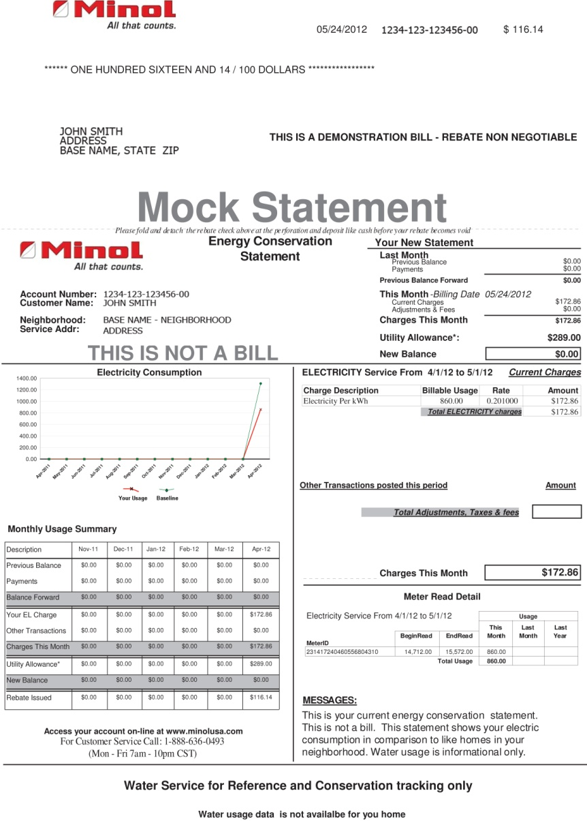
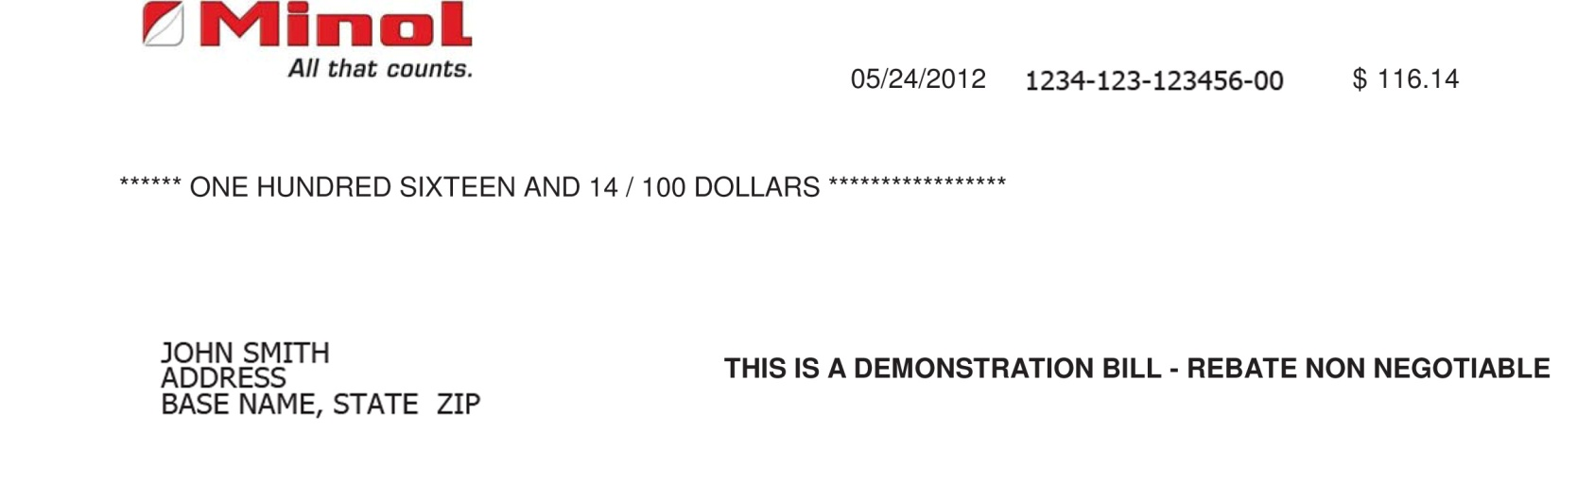
Rebate Due Statement

Slide 29
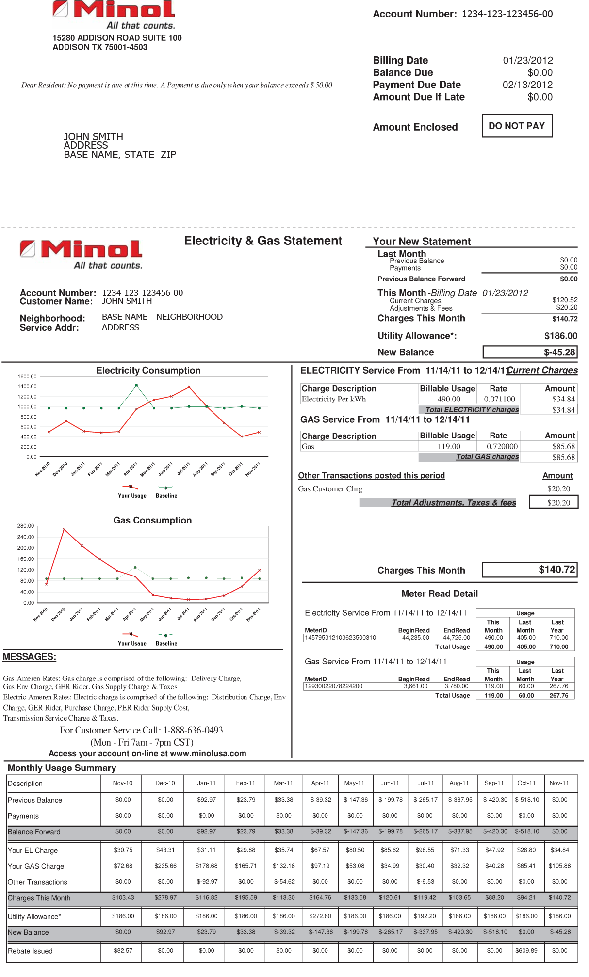
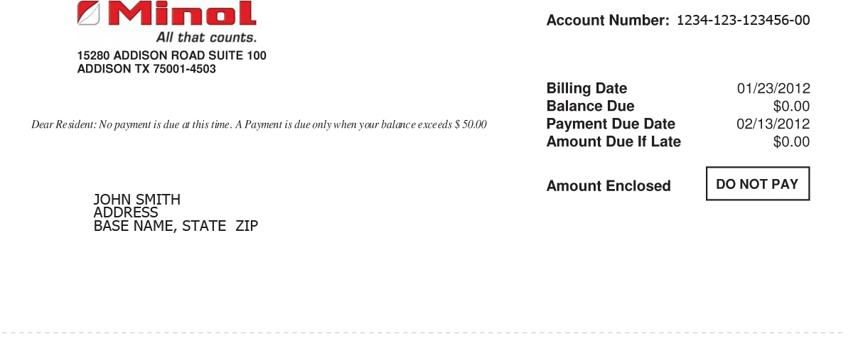
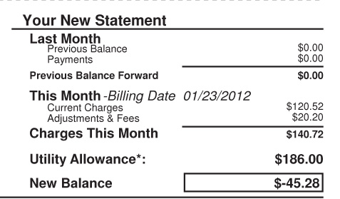
No Action Statement

Slide 30
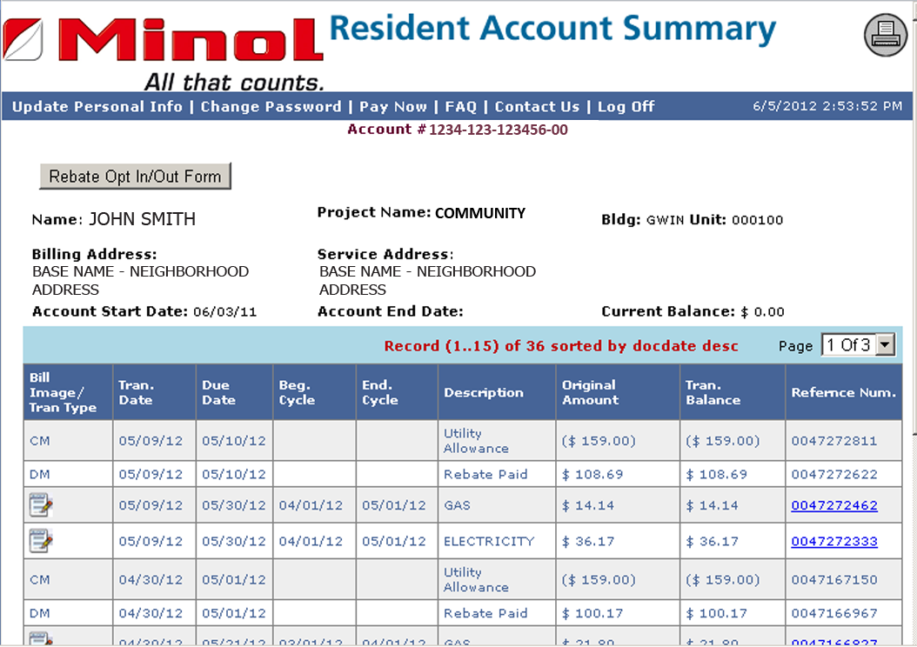


Resident Billing Service
Minol Direct™
  Resident Access
  24/7 Secure Access
Minol Resident Call Center
  Monday-Friday
  7 am - 7 pm CST
  Agents Have an Average of 12 Years
  Customer Service Experience
  Multi-lingual Resident Relations Team
Notes:
30

Slide 31
Minol Direct™
Resident Access
View or Reprint Statement
View all charges & payments at a glance
Pay Online
Update account information

Slide 32



Billing Service
Payment Options
Mail in payment
Online Banking
Pay by Credit Card
Pay by E-Check
Rebate Opt Out/Opt In
Applies Refunds to account
12 Month Period
Reconciled – Opt In or at Move Out
Notes:
32

Slide 33
Energy Use in the Home
Notes:
33

Slide 34
Vampire Electricity
A large number of electrical products—TVs, microwave ovens, computers, monitors, and phone chargers —cannot be switched off completely without being unplugged.
These products draw power 24 hours a day, often without the knowledge of the consumer. We call this power consumption "standby power.“
A typical American home has forty products constantly drawing power. Together these amount to almost 10% to 20% of residential electricity use.
Vampire Electric is estimated to cost US consumers $3 billion a year.
  http://www.energystar.gov/index.cfm?c=about.vampires
http://standby.lbl.gov/
Notes:
34

Slide 35
Useful Links
  2013 Basic Allowance for Housing Component Breakdown:
    http://www.defensetravel.dod.mil/Docs/perdiem/browse/Allowances/BAH/Component_Breakdown/2013-BAH-Rate-Component-Breakdown.pdf
  MCB CAMPEN Family Housing RECP Information Site
      http://www.pendleton.marines.mil/Family/FamilyHousing/ResidentEnergyConservationProgram.aspx
PAO published articles and information
  http://www.pendleton.marines.mil/Family/FamilyHousing/ResidentEnergyConservationProgram.aspx

